Slide 1
Vi-AnonCred The System for Issuing, Verifying, and Revoking the Anonymous Credential based on Smart Contract
Group 1
CS-3372 Final Project Report
Dat Tran ^{(*)}, Cuong Nguyen, Dung Nguyen,
Khiem Nguyen, An Nguyen
Notes:
(*): Team leading

Slide 2
Vi-AnonCred Repo (Full Codework) https://github.com/CS-3372-Anonymous-Credential-Experiment/Vi-Anonymous-Credential
Group 1
CS-3372 Final Project Report
Dat Tran ^{(*)}, Cuong Nguyen, Dung Nguyen,
Khiem Nguyen, An Nguyen
Notes:
(*): Team leading

Slide 3
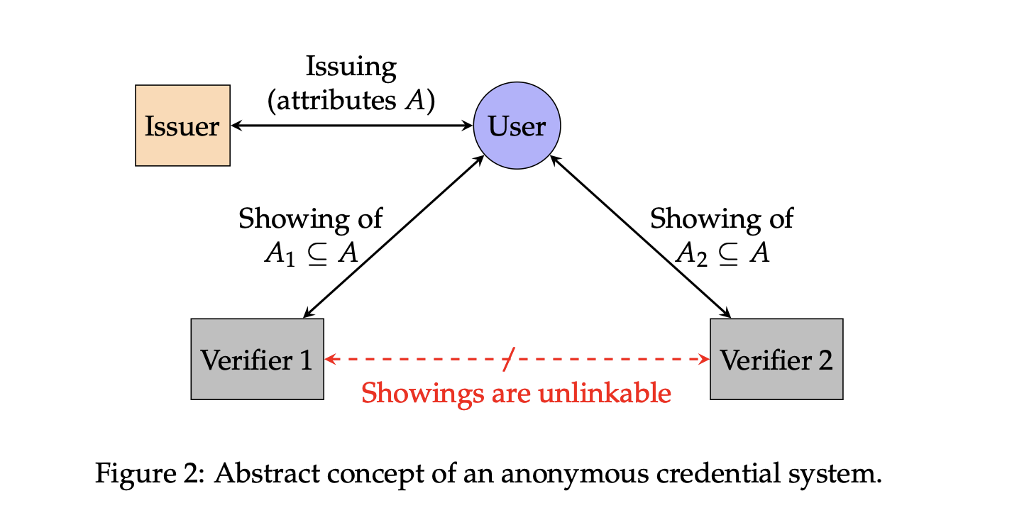
What is an Anonymous Credential System [0]
Notes:
[0] (Slamanig, 2025)

Slide 4
What this problem focusing on
Selective Disclosure
You can only know what I reveal to You,
But not all of my Identity,
My proof is Rigorously & Securely & ZK
Credential Insurance (How Issuer …)
Creating my credentials?
Checking & updating credential Validity (with or without) reveals my identity?

Slide 5
What this problem focusing on
System Construction & Security & Collusion Prevention
I cannot reuse, forge, or replay my proof to you
You cannot use my proof to map to my identity (or break it with a small chance)
Credential Verification
You know that I am valid to use your service, but not my identity
How can everyone (or some people) check whether our transactions are valid without leaking our secret to them or to either of us?

Slide 6
Why We Need & Working on It
Data-Minimilization [8]
(Check your validity, not your identity)
Cost Reduction in Data Maintenance for Application Developer
Notes:
[8]: (Camenisch et al., 2008)
[0]: (Slamanig, 2025)

Slide 7
Why We Need & Working on It
Trustless & No-Trust systems (Logistic & E-Voting system & Currency Exchange & etc.)
Verify your (organization) identity &
Verify satisfiability for transactions
Without privacy invasion [0]

Slide 8
Some Terms We May Use
Credentials: as a set of claims about its holder’s identity [1]
Verifiable Credentials (V.C): A Credential that can be verified by certain evidence [1]
Anonymous Credential: A V.C that can be verified without leaking the holder’s identity with selective disclosure [1] , [8]
Notes:
[1] : Muth, et.al, 2023
[8] : (Camenisch et al., 2008)

Slide 9
Some Terms We May Use [10]
Signature Scheme (S.S): The model of using the algorithm to create a trademark on a certain message.
Signature: The outcome of the Sign algorithm using a certain S.S, which can be Verified later.
Commitment: The Process of hiding data but for later proving
Notes:
[10]: (Stinson, 1995/2019)

Slide 10
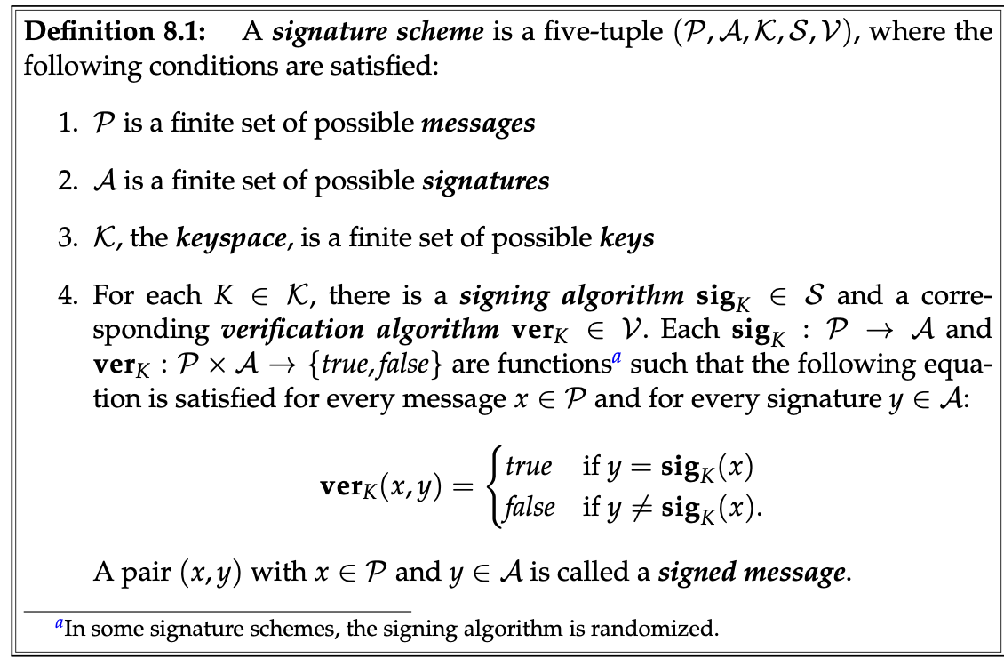
Notes:
Image from (Stinson, 1995/2019)

Slide 11
Some Terms We May Use [0]
Zero-Knowledge (ZK): A special property of a proof is correct without knowing why it’s correct
Zero-Knowledge Proof (ZKP): A proof of a certain statement that is ZK
Proof-Generation: A method or paradigm for writing a ZKP (as ZK-SNARK, STARK, Bulletproof)
Notes:
[0] (Slamanig, 2025)

Slide 12
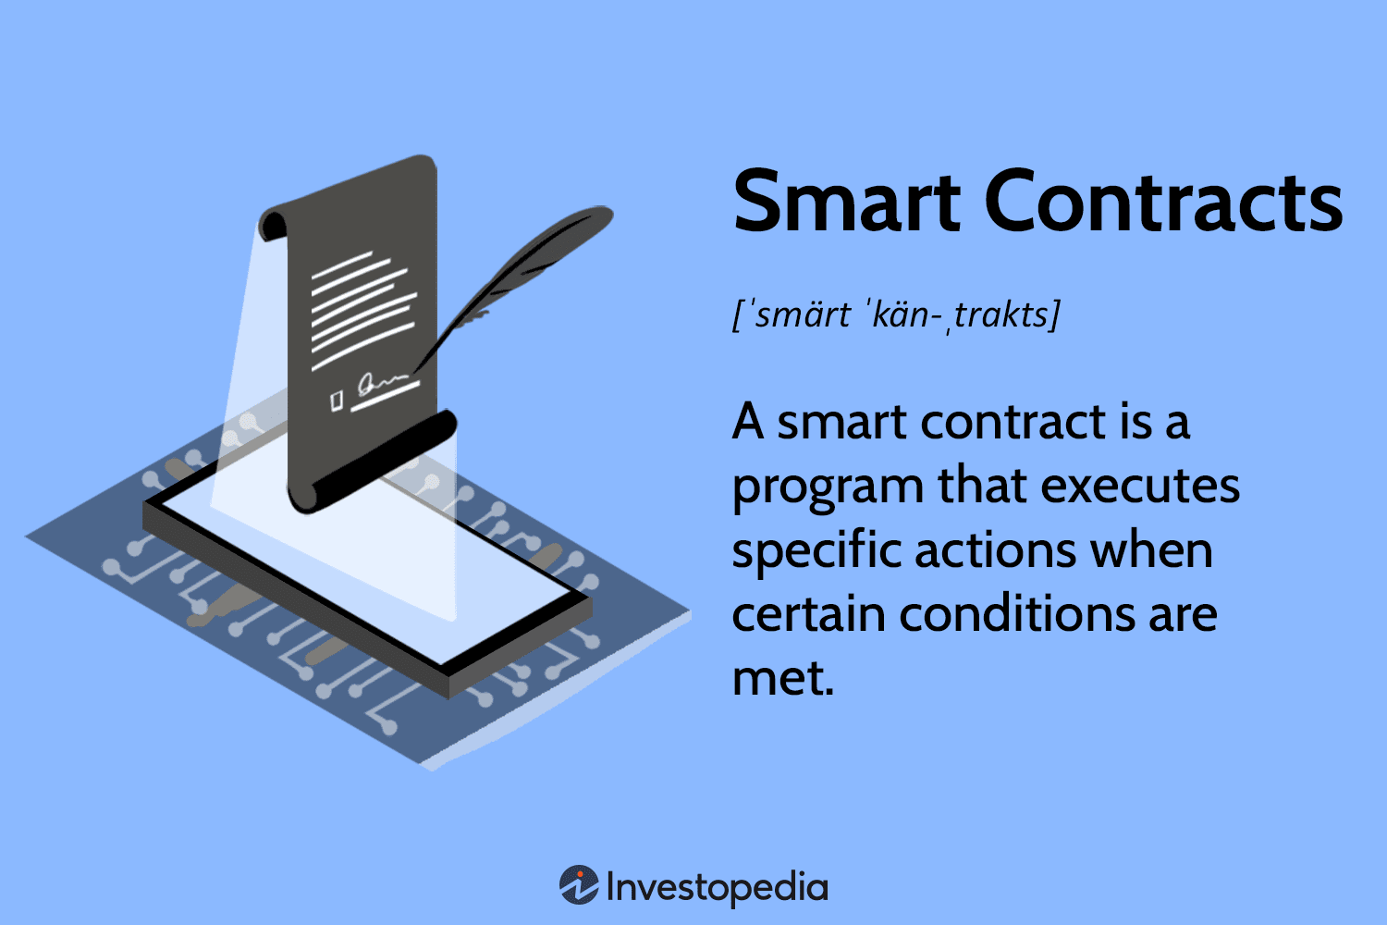
Notes:
[12] – Images from (Investopedia, 2025)

Slide 13
Some Terms We May Use ( [0] & [11] )
Interactive Proof: Prover can interact and send a message to Verifier, and Verifier can send back
Non-Interactive Proof: Prover only sends 1 message to Verifier only
SNARK (zk-SNARK): Succinct Non-interactive Arguments of Knowledge
It’s a non-interactive ZKP, but short & can be verified effectively
Notes:
[11]: (Thaler, 2022)

Slide 14
Abbreviations (Follow [1] & [2])
I: Issuers (Who issue the credential & update the ledger & revoke a credential)
H: Holder (Credential Holder & Prove generator convince the Verifier on a statement(s) )
V: Verifier (a Smart-Contract for checking the H’s proof validity & deploying the proof on-chain)
Notes:
[1]: Muth, et.al, 2023
[2]: (FinCEN - Financial Crimes Enforcement Network, 2019)– Page 18

Slide 15
Abbreviations (Follow [1] & [2])
D-Apps:
Decentralized Application –
a type of autonomous application
not controlled by a centralized party,
with all assets public & accessible
D: Developers
(The ones who write out the smart contract)
by using the data from the ledger
They build the D-Apps that interact with the holder.”

Slide 16
ZKP Proof Between H & V Include
Proof of Being a Valid Credential or Not
Proof Credential being signed by issuer (Signature Verification Algorithm) [13]
Proof of Credential Revocability
Accumulator Model (ZKP) [4], [8]
Merkel-Tree Proving (ZKP) [5], [7]
Notes:
[13]:(Tessaro & Zhu, 2023)
[4]:(Flamini et al., 2025)
[5]:(Laurie & Kasper, n.d.)
[7]: (kd14, 2025),
[8]: (Camenisch et al., 2008)

Slide 17
ZKP Proof Between H & V Include
Proof of User’s Attribute
Range-Proof (Bulletproof) [6]
(In)Equality Proving (out-of-scope) [1]
Notes:
[6] : (Bünz et al., 2017)
[1]: (Muth, et.al, 2023)

Slide 18
Ideal Criteria of Our System [11]
Completeness: A true statement is always convincing
Soundness: No False Statement can be convincing
Efficiency: You can verify my proof within a short-time & my proof is lite
Security: You cannot use my proof on my credential to find or link my identity
Notes:
[11]: (Thaler, 2022)

Slide 19
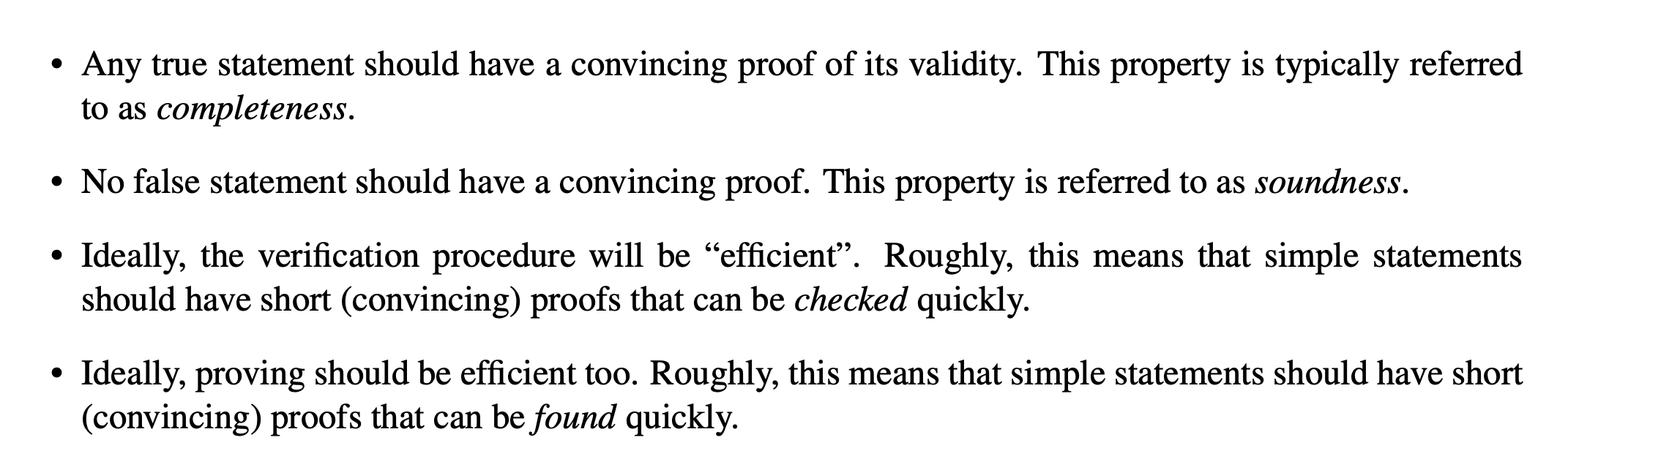
Notes:
From: (Thaler, 2022): https://people.cs.georgetown.edu/jthaler/ProofsArgsAndZK.pdf

Slide 20
The Revocability Protocol
Group 1
CS-3372 Final Project Report
Dat Tran: Accumulator-Based Design
Cuong Nguyen: Merkle Tree-Based Design

Slide 21
How to Handle the Revocability Problem
Common Approaches:
Non-Membership Proving (Proof that your credentials have not been revoked)
Membership Proving (Proof that your credentials are still valid)
In actual system deployment: Rate of Revoked Credential is low [4]
Notes:
[4]:(Flamini et al., 2025)

Slide 22
Accumulator Based Idea
Originally suggested by [12], the Accumulator is:
A Collision-Resistant Hash Function accepts secret inputs, & the result of the hash returns an accumulated value & witness
Each secret input has a ”witness” for creating (non) membership proof of inclusion/ exclusion of the accumulator
Notes:
[12]:(Cohen Benaloh & de Mare, 1993)

Slide 23
Accumulator Enhancement
If a Credential or Values being revoked, all witness of valid holders have to recalculate
But Computation can be expensive & chance of revoke is small
Make the Accumulated Values update by using revoked values (not using the valid values) [4], [13]
Notes:
[4] (Flamini et al., 2025)
[13] (Ioanna Karantaidou & Foteini Baldimtsi, 2021)

Slide 24
Accumulator Enhancement
To simplify the calculation & accumulator construction & we work with the Bi-Linear Pairing Accumulator [14]
We choose to work on Elliptic Curve Encryption – Instead of RSA-based (More secure & lighter accumulator size) [15]
Why is this Secure: Strong Diffie-Hellman (q-SDH) Assumption(s) [8]
Notes:
[14]: (Nguyen, 2005)
[8]: (Camenisch et al., 2008)
[15]: (Computerphile, 2018)

Slide 25
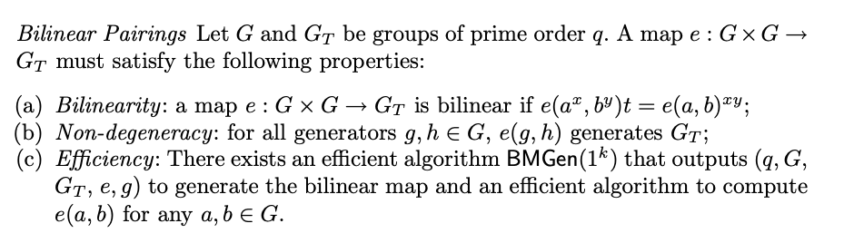
Notes:
[8]: (Camenisch et al., 2008)

Slide 26
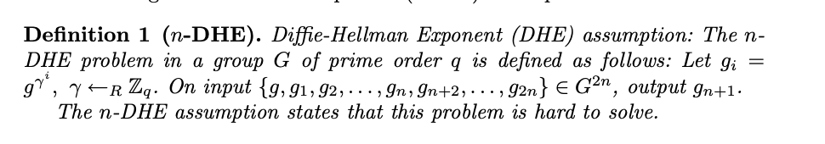
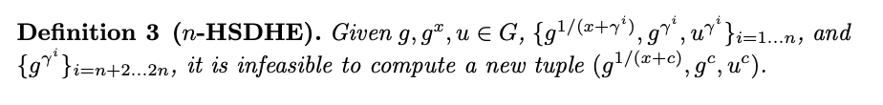
Notes:
[8]: (Camenisch et al., 2008)

Slide 27
How the Accumulator been Constructed [4]
Initialize the accumulated values 𝛂 (no credential being revoked) using issuer’s public parameter + a random exponentiation
Initialize the set of all possible message can sign by issuer (except the secret-key): D
Notes:
[4] (Flamini et al., 2025)

Slide 28
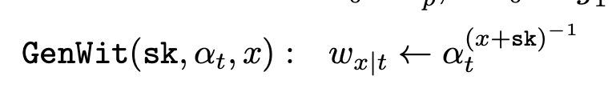
How the Accumulator been Constructed [4]
new witness at time t for an values x defined as
Only update the accumulated values by adding the secret of the revoked holder (x) & publish x to a public list 𝛅
Notes:
[4] (Flamini et al., 2025)

Slide 29
Holder’s Algorithm [4]
Holder can doing the (batch) updates by doing multiplication with past 𝛂(s), and exponentiate using the (list) of delta
Holder can checking the membership inclusion of the accumulator by doing BP-pairing comparison
The process of generating ZKP for membership test is feasible
Notes:
[4] (Flamini et al., 2025)

Slide 30
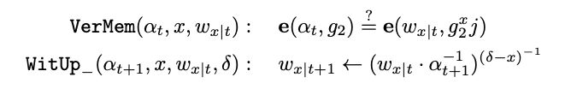
Notes:
[4] (Flamini et al., 2025)

Slide 31
How to creating ZKP with accumulator [4]
Holder’s shall implement the Pedersen Commitment Scheme [16] for hiding the data by doing exponentiation with randomization
Holder would use the “commitment scheme” to hide the secret - the pair of (w,x) and use the commitment for generating ZKP
Notes:
[4] (Flamini et al., 2025)
[16]: (Pedersen, 1992)

Slide 32
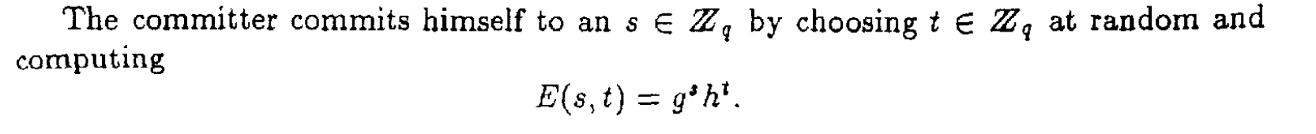
Notes:
[16]: (Pedersen, 1992)

Slide 33
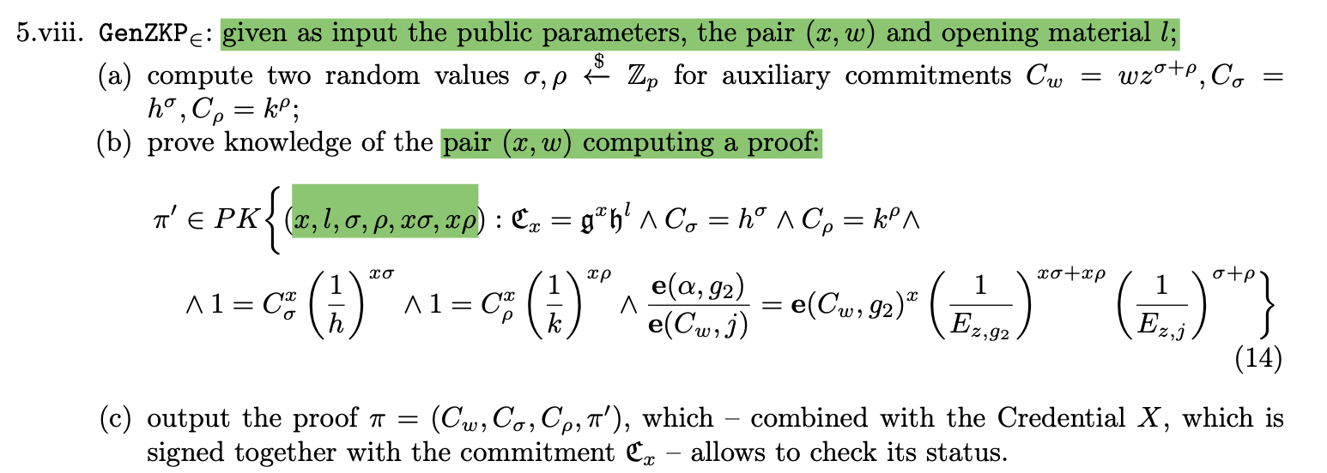
Notes:
[4] (Flamini et al., 2025)

Slide 34
How we can generate the ZKP [15]
ZKP was created by using the Groth16 zk-SNARK scheme
The Scheme was suggest for Bi-Linear Pairing & Elliptic Curve Cryptography
The result of the proof always constant (3 Pairing Elements) -> effective for the verification
The prover computation is linear-scaling with the #proving predicate & ZKP circuit (Not so ideal for prover)
It’s Support Non-Interactive Proof (multiple Verifier can check 1 holders)
Notes:
[15]: (Groth, 2016)

Slide 35
Challenge in integration to On-Chain
The Circuit is not support Group Element Computation
Doing Group comparison (as pairing comparison is costly) by increase
#constrain & #multiplication have to do -> Raise of Gas-Cost

Slide 36
Our Solution
Our Solution: Doing the Group-Element Computation off-chain & hashing the result by using Poseidon Hashing (or MiMC hashing) (circuit-friendly & collision resistant) [16], [17]
If LHS of predicate == RHS of predicate (only Holder can be calculate) -> H(LHS) = H(RHS)
Notes:
[16]: (Grassi et al., 2019)
[17]: (Albrecht et al., 2016)

Slide 37
Some Approach of Hashing
Our Approach (Off-circuit Hashing)
Compute outside, faster efficiency
Circuit only compares commitments
Easier implementation, less secure
Alternative Approach (In-circuit Hashing)
User input → bytes → circuit
Circuit does full hashing
Harder implement, stronger security

Slide 38
HOW TO BRING EVERYTHING ON CHAIN ?

Slide 39
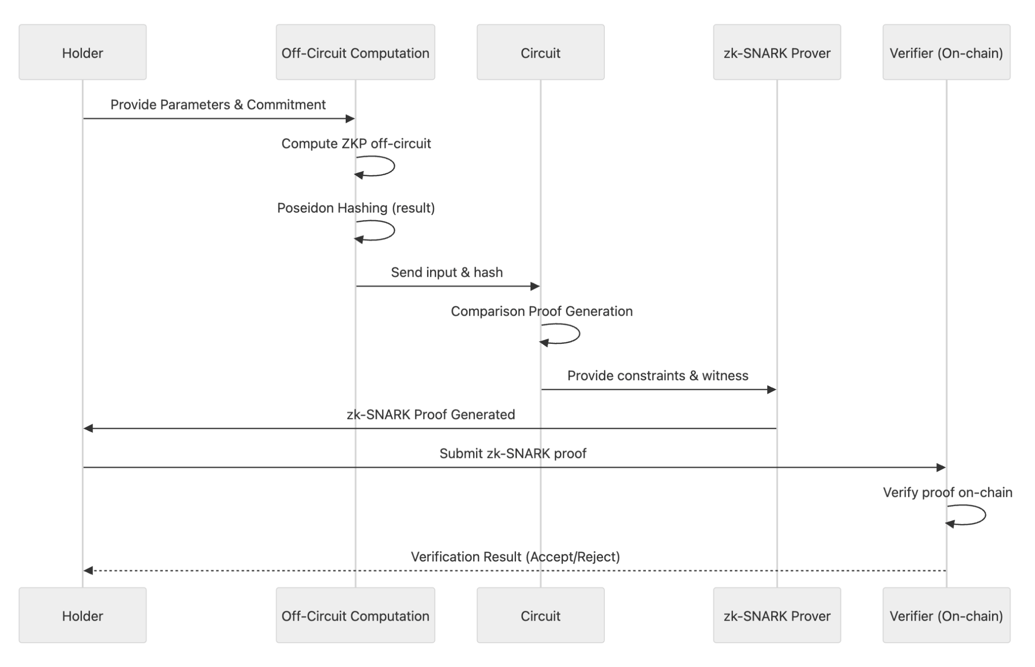

Slide 40
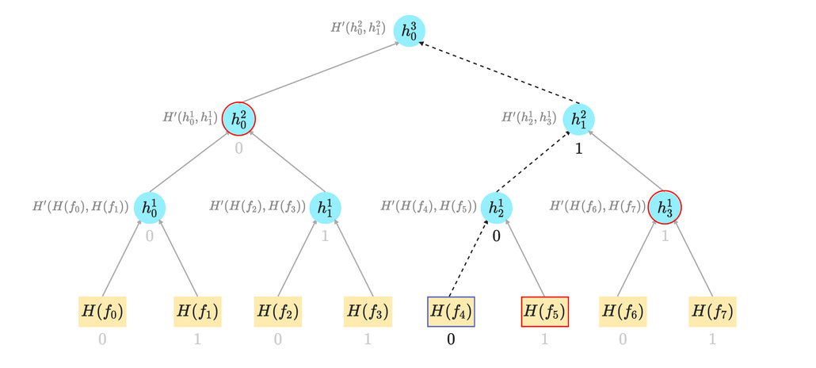
Index Merkle Tree-Based Design
(Tuan Cuong)
Notes:
Why Non-Membership Over Membership Alone?
Membership proofs confirm a UTXO exists, but don’t prevent reuse.
Non-membership proofs are required to prove absence, e.g., ensuring a nullifier hasn’t been revealed (and thus the note hasn’t been spent).
Combined, they deliver correctness (UTXO is valid) and safety (not double-spent).
Systems like Aztec, ZCash, and Nomos rely on non-membership proofs in nullifier trees to ensure privacy and integrity.
Structures like Indexed Merkle Trees and accumulators make non-membership proofs efficient and succinct, often with fixed-size proofs ideal for ZK circuits.

Slide 41
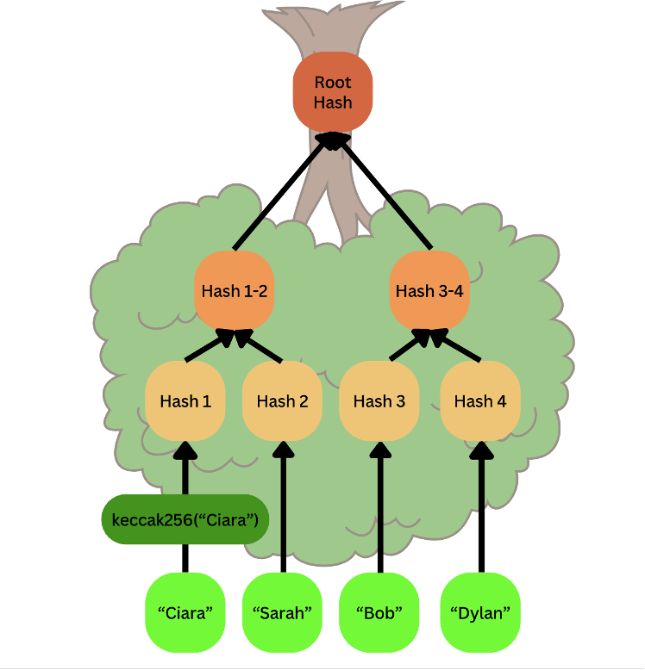
What is Merkel tree
• Definition: A tree structure where each leaf node is a cryptographic hash of its data block, and each non-leaf node is a hash of its direct children's concatenated hashes. [20],[22]
• Purpose: Authenticated data structure; ensures data integrity.
• Root Hash: A single cryptographic hash at the top, representing the entire dataset.
Notes:
(Haider, 2018) - [20]
(“Merkle Tree | Pangea,” n.d.) - [22]

Slide 42
Merkle Proofs: Membership & Consistency
Membership Proof (Merkle Proof/Audit Path):
◦ Proves a given leaf's existence in the tree.
◦ Consists of the leaf's sibling hash and the hashes of non-leaf nodes required to compute the root.
• Consistency Proof (Briefly):
◦ Proves a current root hash is a continuation of a previous root hash.
◦ Used to verify append-only logs.
Notes:
(Haider, 2018) - [20]
(“Merkle Tree | Pangea,” n.d.) - [22]

Slide 43
Merkle Proofs: Membership & Consistency
Verification: Recompute root hash from audit path; if it matches the known root, membership is proven. [20],[22]
Notes:
(Haider, 2018) - [20]
(“Merkle Tree | Pangea,” n.d.) - [22]

Slide 44
The Need for Privacy & Nullifiers Sets
• Problem in Public Anonymous Credentials: Updating state can leak information, even if data is encrypted. [23]
• Solution: UTXO Model & Two Trees:
◦ Commitment Tree (State Tree): Stores commitments (hashes) to private data units, called 'notes' [25,26]. Append-only.
◦ Nullifier Tree (Nullifier Set): Tracks 'nullifiers' of spent notes to prevent double-spending [24,26].
• Nullifiers: Unique identifier for a spent note, deterministically derived from note's contents (e.g., hash of secret key + commitment) [24].
• Proof: To spend a note, prove its nullifier is not in the nullifier set [21].
• Goal: Scalable and performant structure for ever-growing nullifier sets, with efficient non-membership proofs [24].
Notes:
“Indexed Merkle Tree (Nullifier Tree) | Privacy-First ZkRollup | Aztec Documentation” (2025) - [21]
(Privacy Stewards of Ethereum, 2023) - [23]
(Nomos Team, 2025) - [24]
(“Notes (UTXOs) | Privacy-First ZkRollup | Aztec Documentation,” 2025) - [25]
(“Notes, Nullifiers, and Trees,” 2025) - [26]

Slide 45
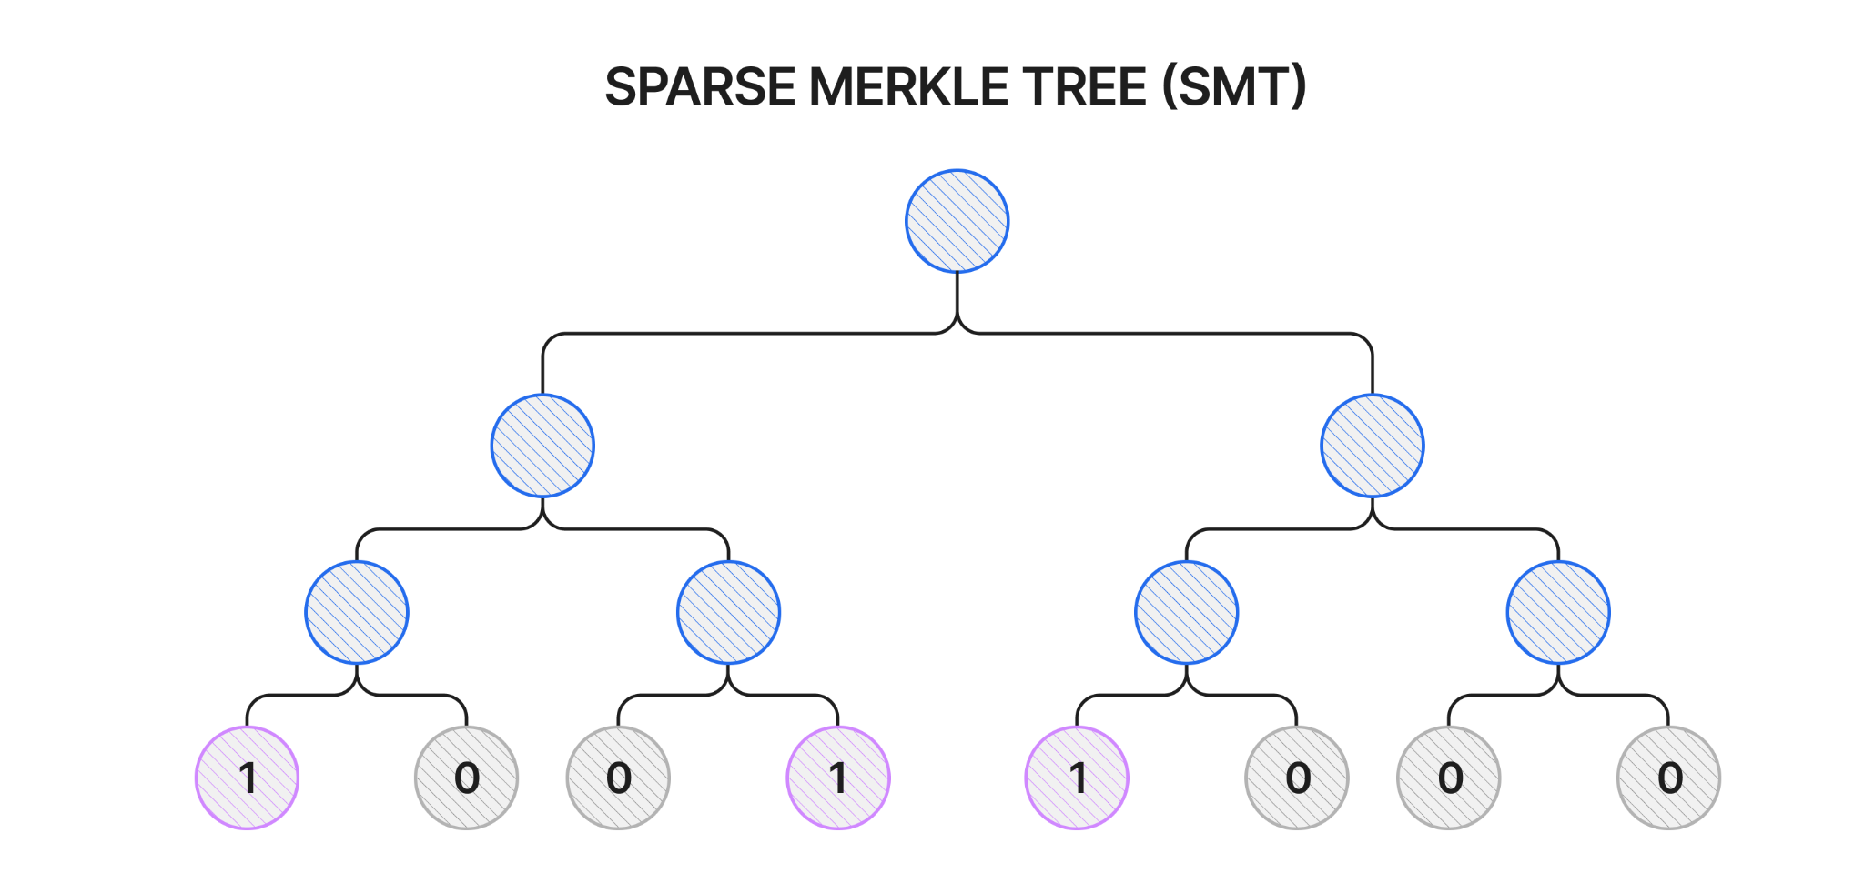
Sparse Merkle Trees (SMTs) as Nullifier Trees
• Concept: A Merkle tree of "intractable size," where only a few leaf nodes have valid data, making it sparse [20].
Notes:
(Haider, 2018) - [20]
(“Indexed Merkle Tree (Nullifier Tree) | Privacy-First ZkRollup | Aztec Documentation,” 2025) - [21]
(Privacy Stewards of Ethereum, 2023) -[23]
(Nomos Team, 2025) -[24]
• Structure [24]:
◦ Fixed, very large size (e.g., (2^{256}) leaves for 256-bit nullifiers).
◦ Leaf's index corresponds to the stored value.
◦ Presence: Leaf set to 1. Absence: Leaf initialized to default 0.
◦ Only non-empty leaves and necessary internal nodes stored.

Slide 46
Non-Membership Proof with SMT
• Non-Membership Proof: Retrieve Merkle path to relevant leaf; if value is 0, non-membership is proven [20, 24].
• SMT Advantages [24]:
◦ Easy non-membership proofs (same as membership).
◦ Constant proof size due to fixed depth.
◦ Simple structure and append mechanism.

Slide 47
Non-Membership Proof with SMT
• SMT Drawbacks:
◦ Fixed depth leads to complex ZK circuits: e.g., 254 hashes for 256-bit nullifiers [21, 24].
◦ High computation cost:
Notes:
Explain why using SMT is not so good for non-membership proof
◦ 508 hashes per nullifier insertion in Aztec Connect (254 for non-membership check + 254 for insertion) [21, 23].
◦ Insertions are random, leading to linear scaling of hashes with number of nullifiers inserted [21].
◦ Not ideal for small datasets [24].

Slide 48
Introducing Indexed Merkle Trees (IMTs)
• Concept: A type of Merkle tree where leaf nodes maintain additional pointers, creating an ordered structure similar to a linked list [21, 24].
• Key Feature: Each leaf includes a pointer to the next-highest value leaf.
Notes:
(“Indexed Merkle Tree (Nullifier Tree) | Privacy-First ZkRollup | Aztec Documentation,” 2025) - [21]
(Nomos Team, 2025) - [24]

Slide 49
Benefit of IMTs
• Benefits:
◦ Efficient range and adjacency checks.
◦ Support for batch inclusions.
◦ Optimized non-membership proofs.
◦ Dynamic growth, unlike SMTs' fixed size.

Slide 50
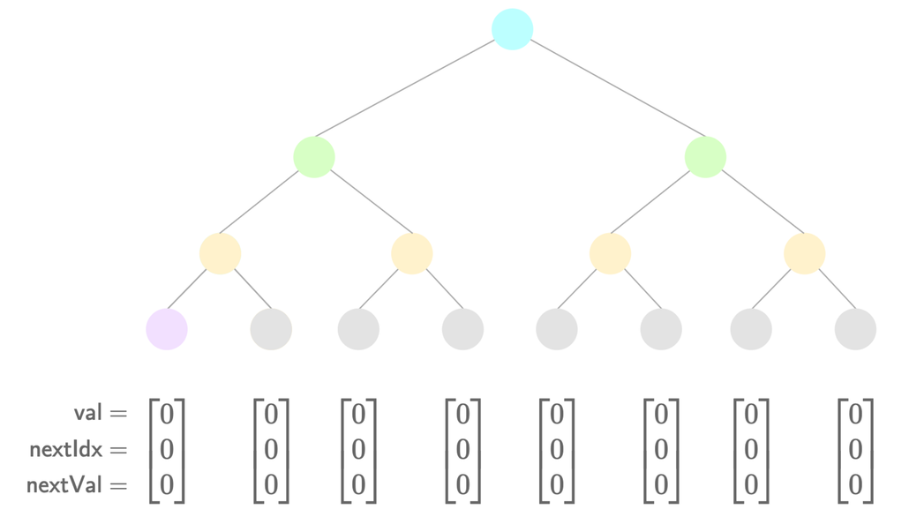
How IMTs Work: Structure & Instruction

Slide 51
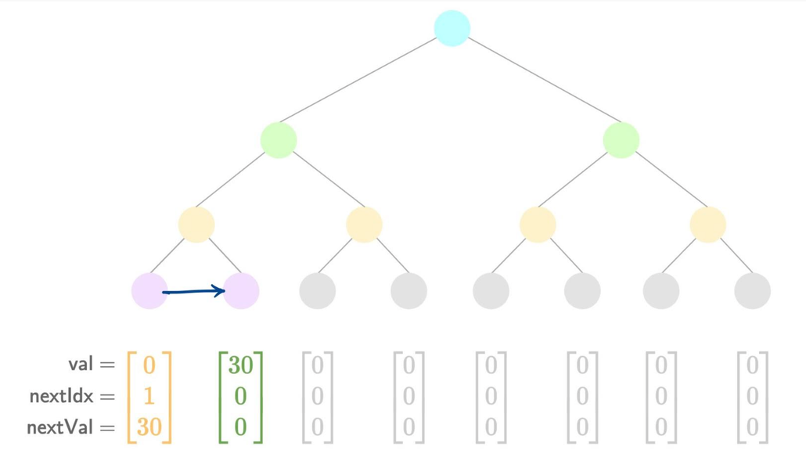

Slide 52
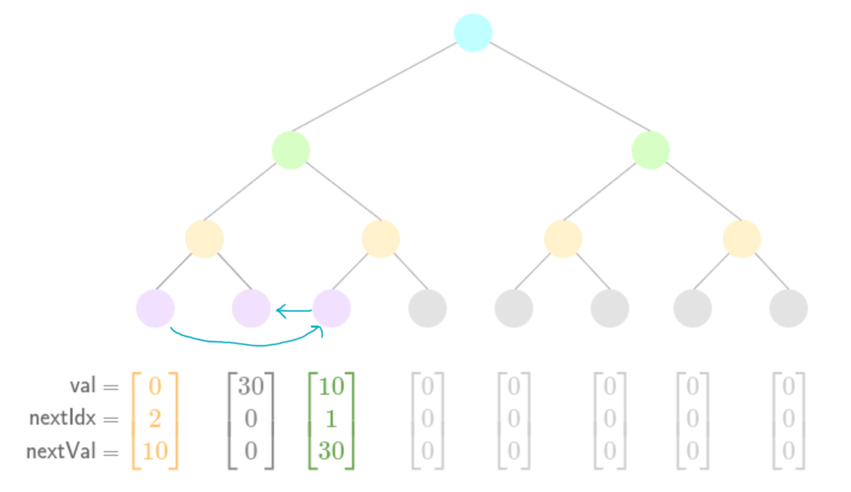

Slide 53
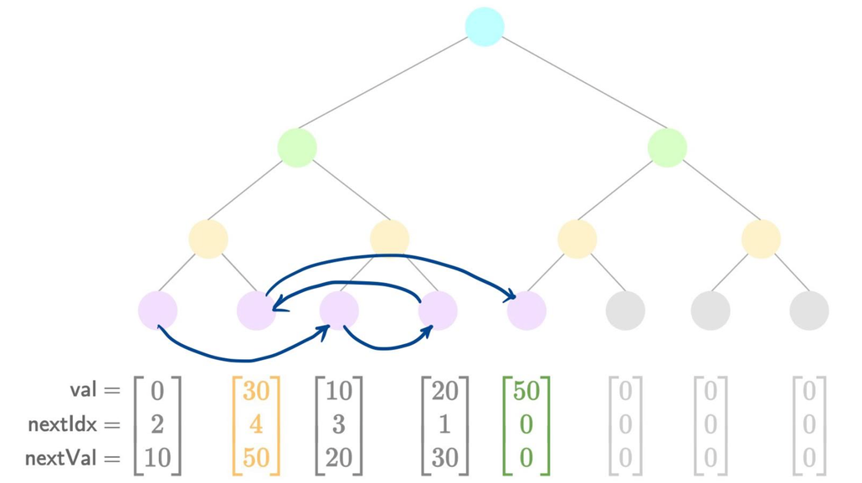

Slide 54
IMT Non-membership Proofs
• Core Idea: To prove non-membership of a value X, reveal the Merkle path to the 'low nullifier' (the predecessor element) [21, 24].
• Low Nullifier: The leaf whose value is less than X, but whose next_value is greater than X (or 0 if X is the largest).
Notes:
(“Indexed Merkle Tree (Nullifier Tree) | Privacy-First ZkRollup | Aztec Documentation,” 2025) - [21]
(Nomos Team, 2025) - [24]

Slide 55
IMT Non-membership Proofs (Cont)
Verification:
1. Hash the low nullifier (its value, next_index, next_value).
2. Prove low nullifier membership in the tree (using its Merkle path to the root).
3. Perform Range Checks:
▪ Assert X > low_nullifier.value.
▪ Assert X < low_nullifier.next_value OR low_nullifier.next_value == 0 (for max value).

Slide 56
IMT Non-membership Proofs (Simplified)
• Performance Improvement:
◦ Smaller Tree (no more index, so it’s shallow - 32 levels is fine)
◦ Few Hash (from 32 hash to 254 hash; faster in computation)
◦ Faster Insertion (8 times quicker than SMT)

Slide 57
IMT Non-membership Proofs (Detail)
• Performance Improvement:
◦ No longer tied to value-as-index, so arbitrarily small tree depth (e.g., 32 levels suffice for Aztec).
◦ Massive reduction in hash operations: 32 hashes per proof vs. 254 for SMTs.
◦ An ~8x improvement in insertion performance (256/32).

Slide 58
We can do better : Batch Insertion in IMTs
• Concept: Leverage adjacency pointers to insert multiple nullifiers as a subtree in a grouped operation [21, 23, 24].
• Benefit: Significant efficiency increase, especially beneficial for rollup circuits.
Notes:
(“Indexed Merkle Tree (Nullifier Tree) | Privacy-First ZkRollup | Aztec Documentation,” 2025) - [21]
(Privacy Stewards of Ethereum, 2023) - [23]
(Nomos Team, 2025) - [24]

Slide 59
Batch Insertion in IMTs (cont)
• Process:
1. Sort new nullifiers and group into a subtree.
2. Prove the target subtree location is currently empty.
3. Update pointers for all new nullifiers and existing low nullifiers affected by the batch.
4. Insert the entire subtree.

Slide 60
Batch Insertion in IMTs (cont)
• Performance Gains:
◦ Amortizes hash costs: Instead of separate proofs and updates for each nullifier, operations are batched.
Notes:
◦ Example for 4 values (Aztec's figures):
▪ SMT: 2032 hashes (4 * 508).
▪ IMT (depth 32): ~327 hashes (1 non-membership check, 1 pointer update per value, plus subtree construction/insertion cost).
◦ Significant efficiency increase, especially beneficial for rollup circuits.

Slide 61
IMT Advantages
• Advantages:
◦ Compact & Dynamic: Grows with data, avoiding vast, sparse trees [24].
◦ Efficient Proofs: Smaller tree depths mean fewer hashes per proof (e.g., 32 vs 254) [23,24].
◦ Better for Smaller Datasets: More computationally efficient when the number of nullifiers is not at maximum capacity [24].
Notes:
(“Indexed Merkle Tree (Nullifier Tree) | Privacy-First ZkRollup | Aztec Documentation,” 2025) - [21]
(Privacy Stewards of Ethereum, 2023) - [23]
(Nomos Team, 2025) - [24]

Slide 62
IMT Advantages (Cont)
◦ Batch Insertion Efficiency: Amortized costs (Average cost/operation sequences) for multiple insertions is low [21].
◦ "Engineering Fix": Shifts computation outside the ZK circuit where possible [23].

Slide 63
IMT Disadvantages (Simplified)
• Disadvantages [21.24]:
◦ Implementation Complexity when scaling
◦ ZK Circuit Complexity dues to adding sub-tree
◦ Off-Circuit Sorting
◦ Increased Storage per Node

Slide 64
IMT Disadvantages (Detail)
• Disadvantages [21.24]:
◦ Implementation Complexity: Harder to implement due to pointer management and dynamic growth.
◦ ZK Circuit Complexity: Must accommodate maximum subtree size for batch updates.
◦ External Sorting: Elements for batch updates must be sorted outside the circuit.
◦ Increased Storage: Greater storage for adjacency pointers and maintaining a sorted data structure for nodes.

Slide 65
HOW A ZKP BEING GENERATED WITH MERKLE TREE

Slide 66
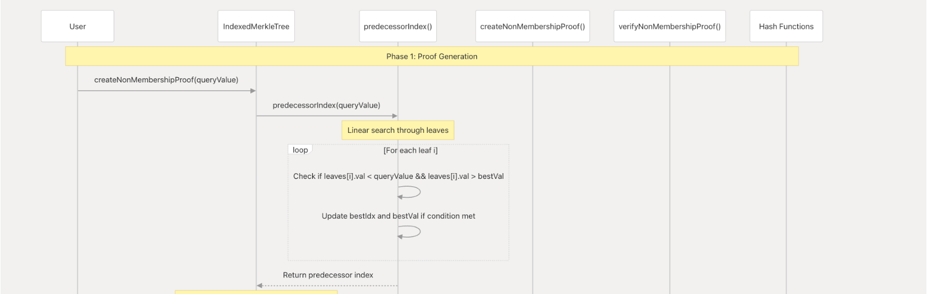

Slide 67
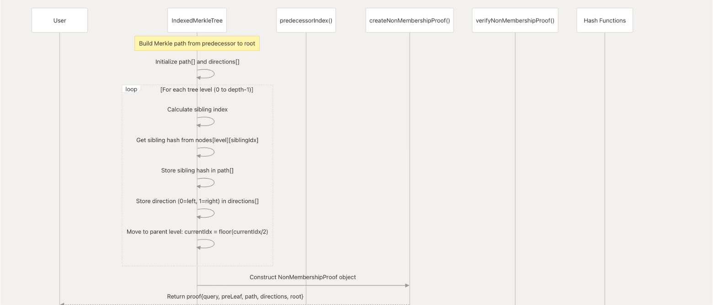

Slide 68
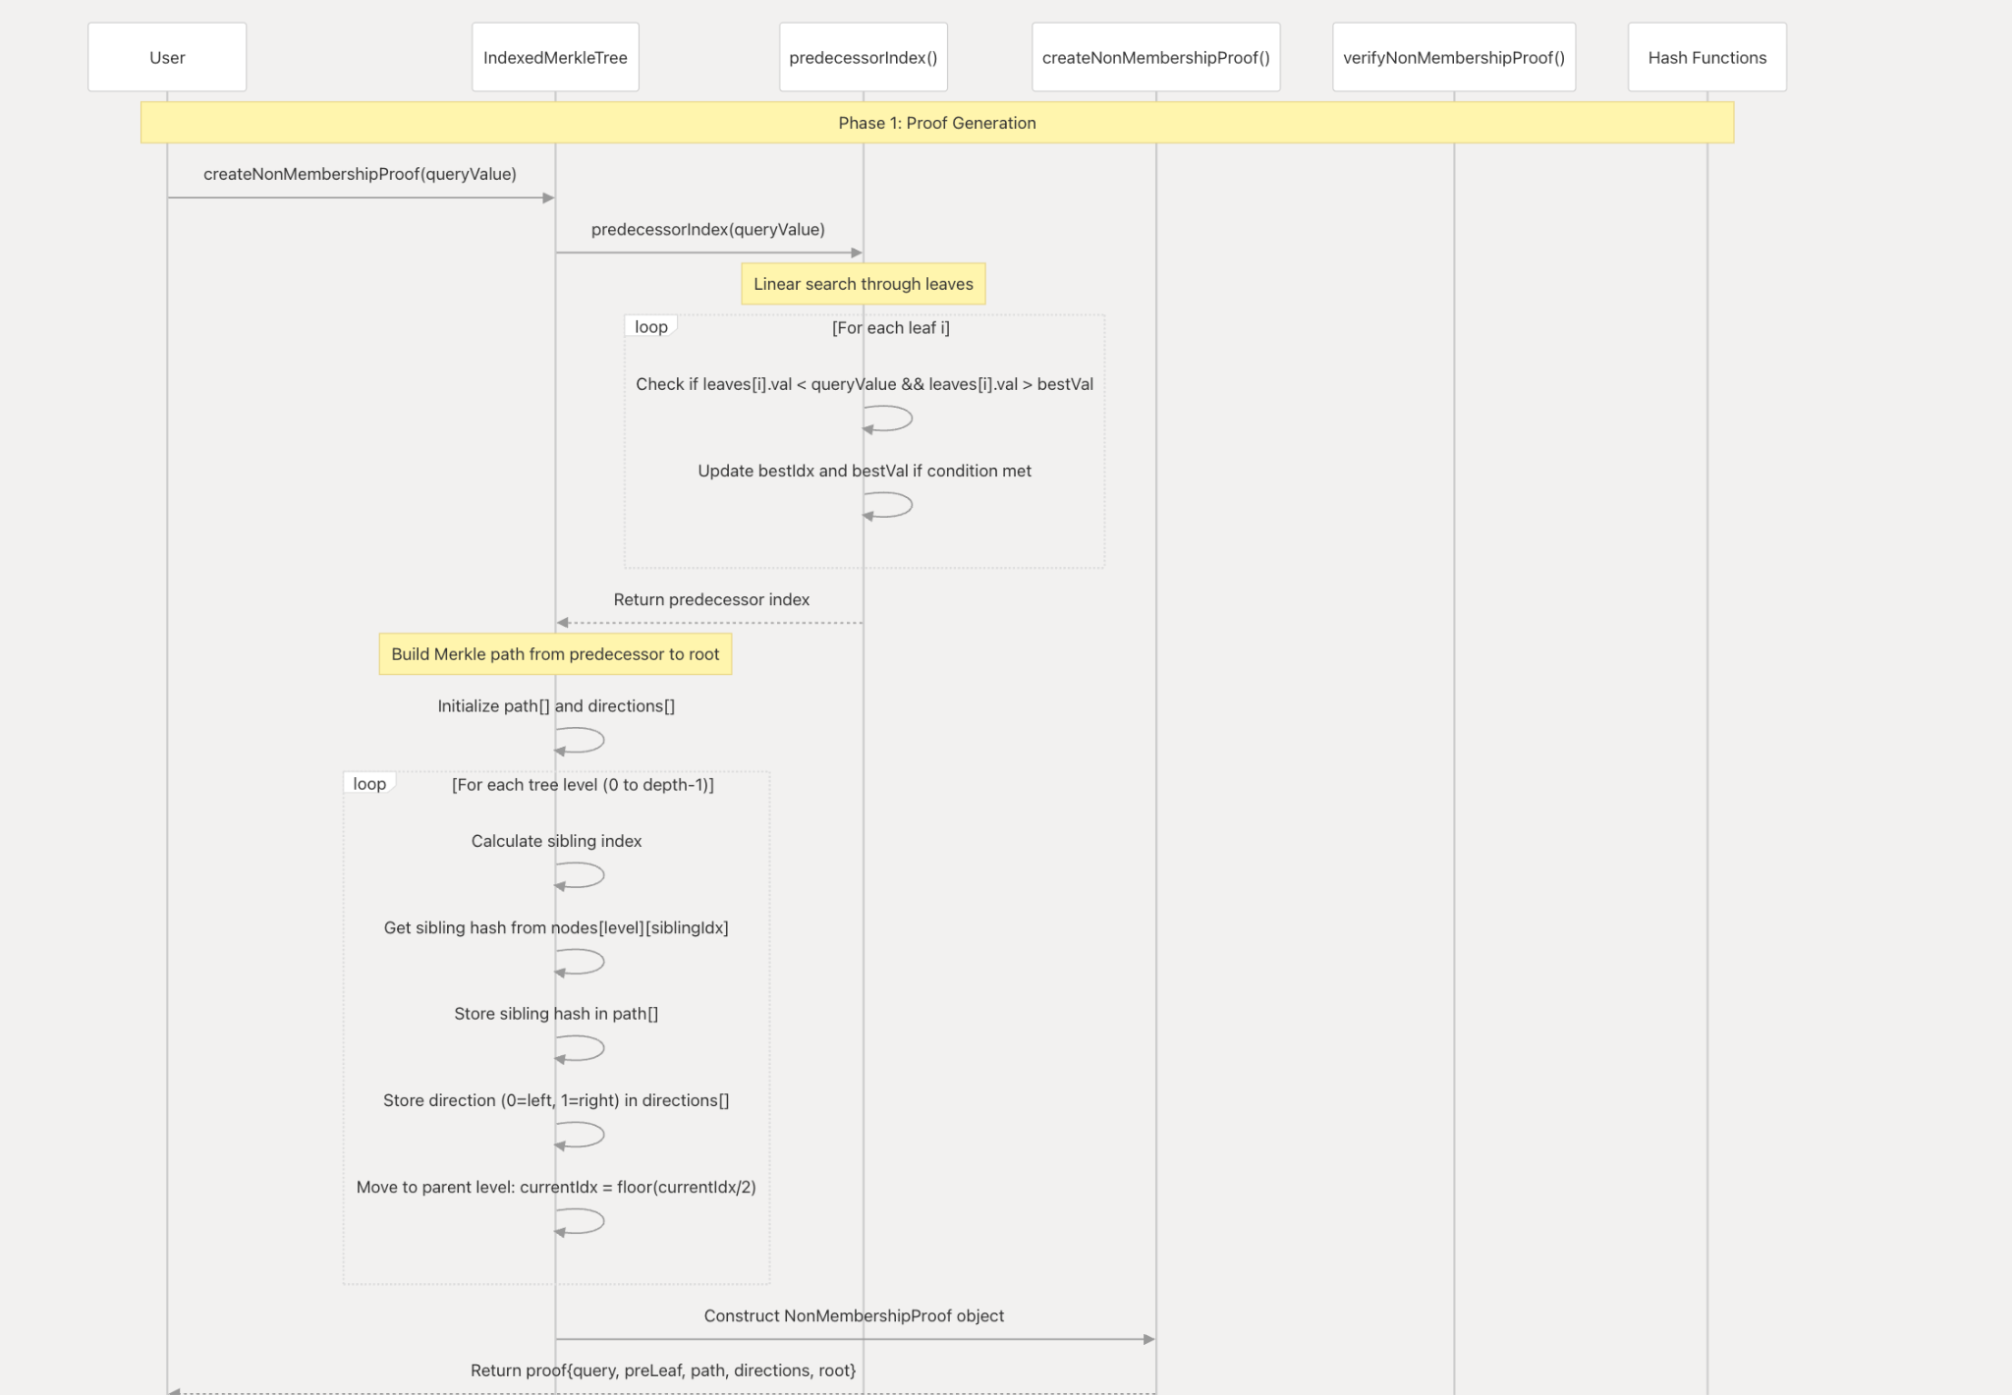

Slide 69
HOW A ZKP BEING VERIFIED WITH MERKLE TREE

Slide 70
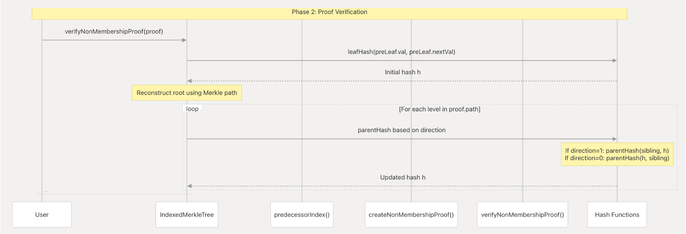

Slide 71
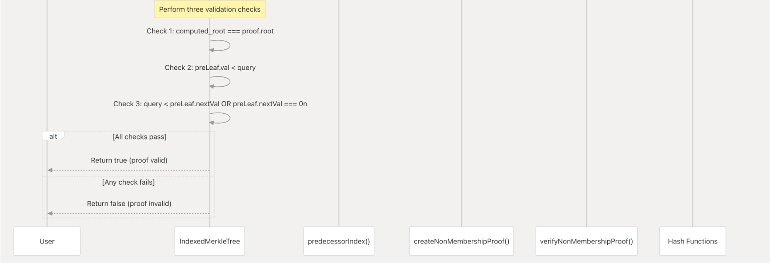

Slide 72
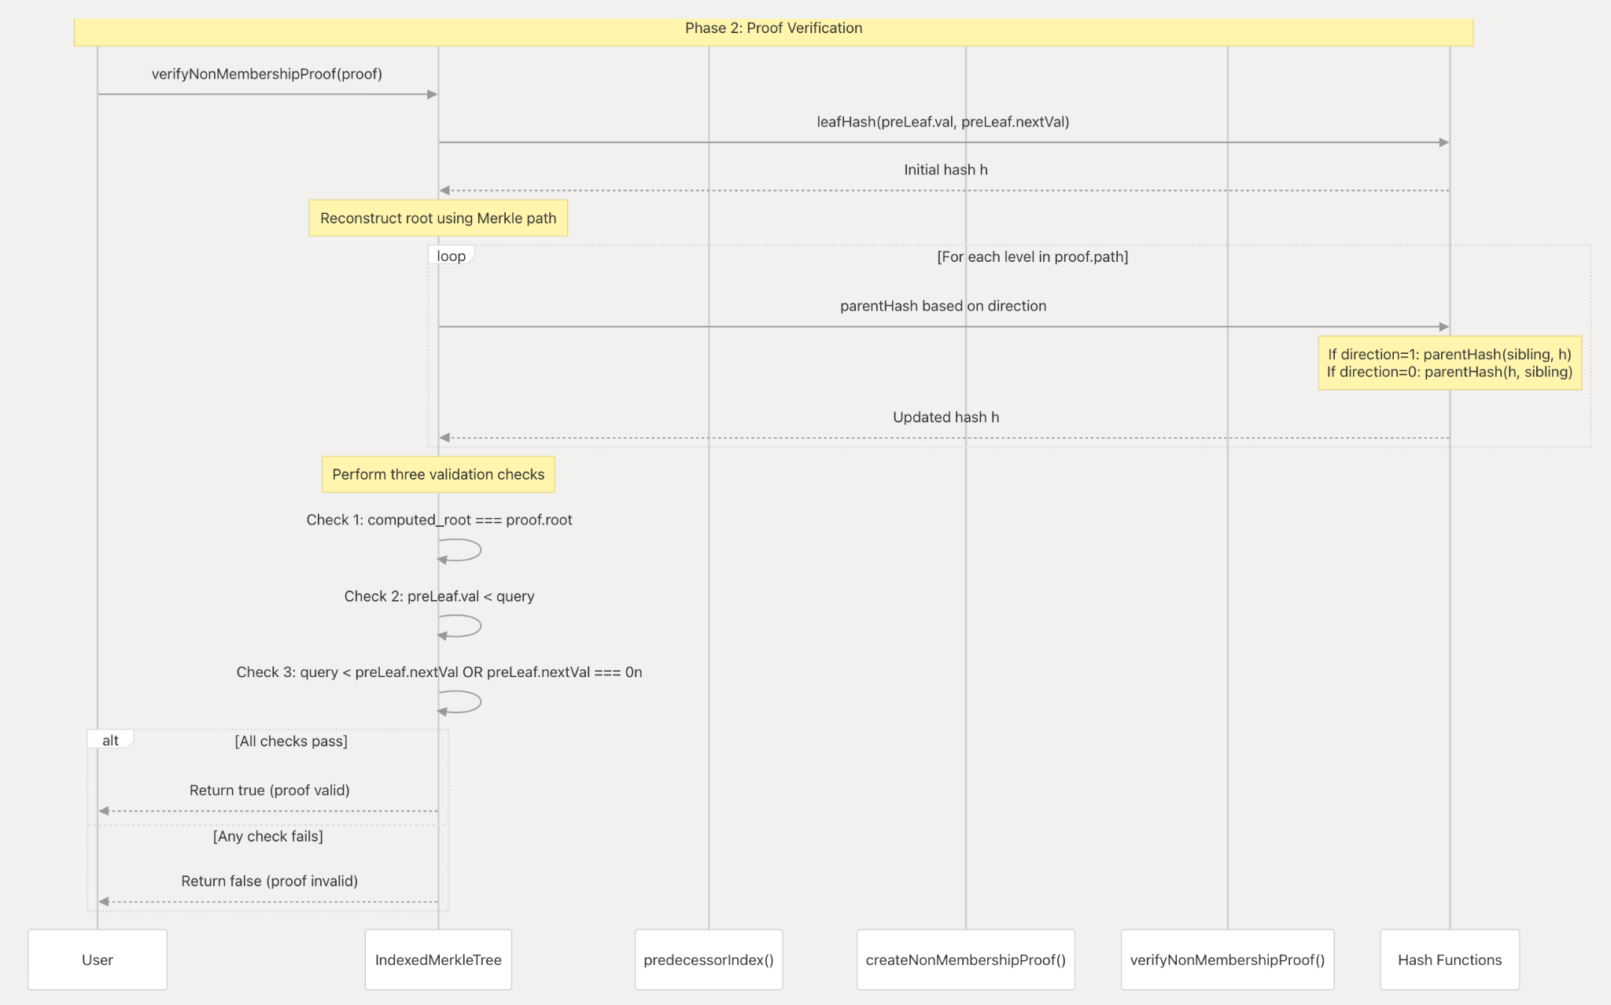

Slide 73
The Attribute Proving Protocol
Group 1
CS-3372 Final Project Report
An Nguyen: Bulletproof-Based Protocol Off-Chain
Dat Tran: On-Chain Deployment of Bulletproof

Slide 74
Why We Choose Bulletproof for Attribute Proving ?
Blockchain transactions lack confidentiality
Range proofs needed to ensure amounts are valid
Earlier solutions: large proof size or trusted setup [6]
In this Experiment
Bulletproofs is used for efficient range proof,
Smaller/ compact proof size

Slide 75
Limitations of Earlier Range Proofs [6]
Linear-size range proofs: proof grows with bit length of data
Trusted setup requirements in SNARKs
Practical inefficiency in Bitcoin confidential transactions or any on-chain deployment

Slide 76
Bulletproofs Introduction
• Non-interactive zero-knowledge proof system [6]
• No trusted setup, relies only on discrete log assumption
• Proof size logarithmic-scaling in range size: 2 log₂(n) + 9 elements

Slide 77
Range Proofs in Bulletproofs
• Prove committed (secret) value lies within a range - from [0, 2^n -1]
• Compact proofs, suitable for confidential transactions
• Support batch verification for efficiency [6]

Slide 78
The Idea of doing bullet-range proof (Brief)
Use Pedersen Commitment with randomization to prove a secret value v.
Show that v satisfies a dot-product relation on its binary representation without revealing it.
Reject if v is out of range or has no valid binary representation.

Slide 79
The Idea of doing bullet-range proof
Proving a number in the Range by using the Pedersen Commitment + Randomization to proof a secret-values v that satisfy a certain dot-product relation about v’s binary-representation. (Inner-Product Argument)
By showing the holder’s values exist a valid binary representation in the verifier range (without leaking v or it’s (in)direct binary representation )
If values not in the range (negative || too big) -> not exist as valid binary-representation -> Reject

Slide 80
The Statement bullet-range proof try to Solve [6]
The Statement that Inner-Product Try Proof [6]
g,h,a,b are vectors, u, P are group elements

Slide 81
Aggregation & Applications
Aggregate m range proofs with only O(log m) overhead (extra-work) [6]
Able to do multiple attribute verification
Applications:
Confidential transactions
Solvency proofs (Provisions)
Smart Contracts Deployment (Our-case)

Slide 82
Using MiMC to Make Bulletproof on-chain
Bulletproof is not able to bring on-chain as Ethereum network yet
Solution: Doing the Hash the proof & check it’s result on-chain
Challenge:
Secure ZKPs need efficient primitives for Circuit construction
Linear operation are cheap, multiplications as (bit-shift , XOR) are expensive [17]
Goal: reduce multiplicative complexity in the Hashing Process
Hashing Parameters set-up need to be simple (Poseidon setup is complicated)
Notes:
SHA-256 work overbit using XOR, AND gate -> these gate convert to arithmetic gate for generating ZkP is majorly in multiplication -> costly in circuit

Slide 83
MiMC Design
The MiMC hashing based on the Sponge-Construction in [18]
To map one input bit-string chunks (each chunk size r) to a fix-length string (n)
The Hashing-Function (or Sponge) have an internal state (state-machine) able to update after each hashing iteration
The State is a Binary-String (can be manipulated)
Notes:
[18]: (Bertoni et al., 2008)

Slide 84
MiMC Hashing Algorithm (Short Version)
The MiMC Hashing Include 3 keys steps
Initialization: Set up the starting state with input and key.
Absorption: Mix the input into the state through nonlinear rounds.
Compression: Reduce the final state to produce the hash output.
The Absorption & Compression depend on the Data-Mixing Process using Special Permutation Function (P) -> need to be engineer carefully for security
Notes:
[18]: (Bertoni et al., 2008)

Slide 85
MiMC Hashing Algorithm [18] & [19]
Initialization
Cut the input string to equal chunks C with of size r (padding allow)
Initialize the String S randomly (len(S) = r + c)
Notes:
[18]: (Bertoni et al., 2008)
[19]: (Lefevre, 2023)

Slide 86
MiMC Hashing Algorithm [18] & [19]
2. Absorption
For all chunk m in C does:
pad c Zeros on right end of current-chunk a bunch of 0 (security part)
get string L = (m || 0^c)
Doing the bitwise adding (XOR) between current S ⊕ L
Change the state <Permutate S> (Do 1 in 3 options below)
Doing Non-Linear Transformation P[(S + L)] string = S (new-state) only <*>
Swapping each bytes by apply a rule P to get S only
Combine 1 + 2 -> S
Notes:
Permuting = Structural Scrambling for prevent information loss
Permulation with string mapping from 1 string to another -> usign Function
<*> Some hashing algorithm as AES actually does bytes-swaping - but not with MiMC

Slide 87
MiMC Hashing Algorithm [18] & [19]
3. Data Compression
From 1 to n / r: (n is desired length, r: chunk length == rate)
Take r outter bits of S
Permutate S again
Notes:
[18]: (Bertoni et al., 2008)
[19]: (Lefevre, 2023)

Slide 88
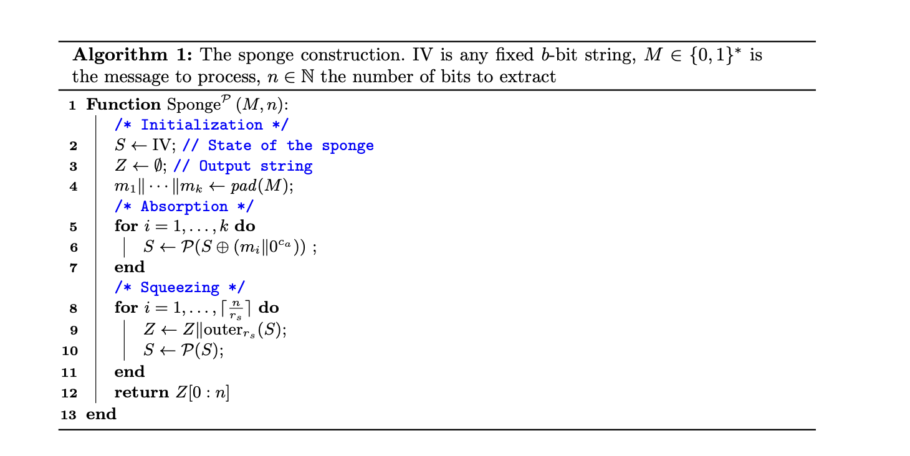
Notes:
Images From [19]

Slide 89
MiMC Permutation Function Design
Permutation Function P is Essential for Security
How to Build P:
Build the Rounding function F(x) = x^3 mod P (P is large)
x being argument with k (the key) & a constant c by XOR
each times doing the hashing, use a unique c (rounding constant) & accepting last iteration rounding input

Slide 90

MiMC The Permutation Function F [17]
The first & last round const c = 0
Choosing c values from [1 to r-2] is matter for hashing security

Slide 91
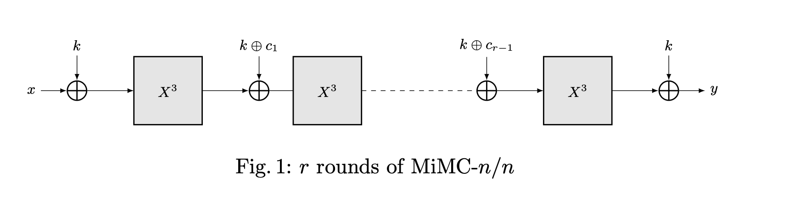
Notes:
Image from [17]

Slide 92
MiMC as a Hash Function Application
Applications: zk-SNARKs, verifiable computing
Outperforms SHA-256 in SNARK contexts [17]
Why: Only doing the addition on bits & less on multiplication

Slide 93
Integration with zk-SNARK
MiMC provides efficient in-circuit hashing (for bring the bulletproof to on-chain verification)
Bulletproofs ensure short range proofs with no trust and compact-size ~ log(#attribute or #asked predicate)
Together: efficient attribute proving protocol

Slide 94
Attribute Proving Flow
Commit to attributes with Pedersen commitments
Off-Chain Validity Proof with Bulletproofs
Off-Chain Hashing with MiMC
Generate On-Chain Proof with zk-SNARK
On-Chain Verification

Slide 95
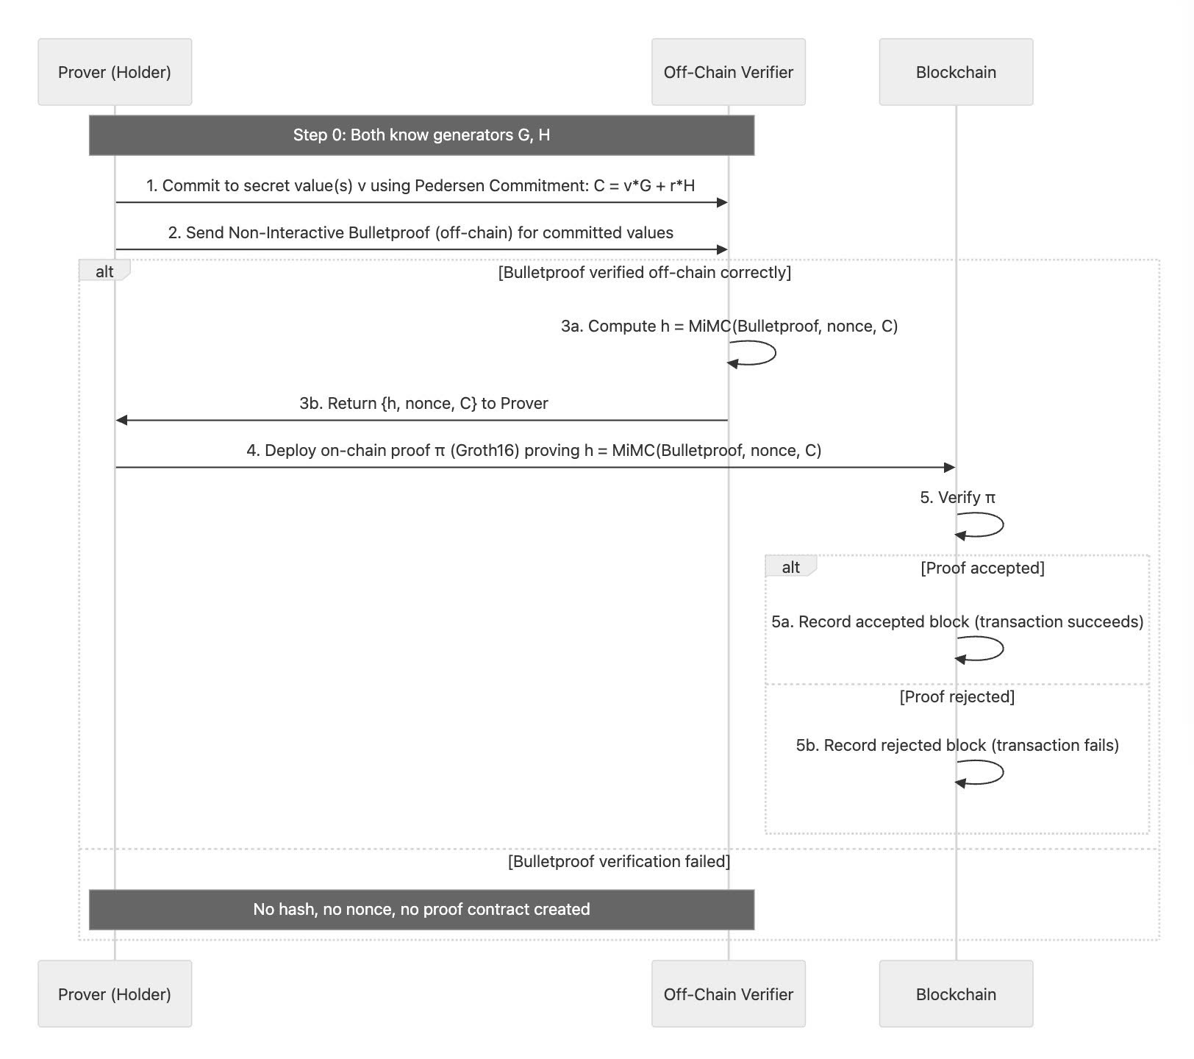

Slide 96
The System Designing
Group 1
CS-3372 Final Project Report
Khiem Nguyen: Off-Chain Designing
Dung Nguyen: On-Chain Designing

Slide 97
But Why Have to be on Blockchain ? [1]
Decentralized System & Trustless environment between parties
Removing the trust (or Less Trust)
Reducing Collusion opportunity
Better Security
Prevent Forgery & Easy to Recheck later
Notes:
[1]: Muth, et.al, 2023

Slide 98
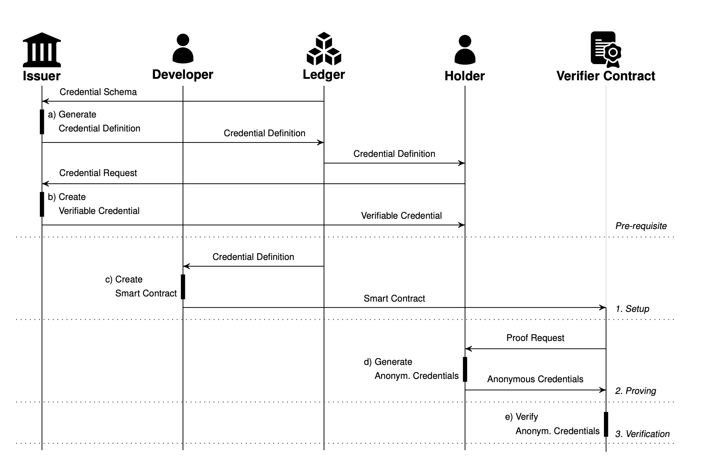
The Whole Pipeline – Muth et al., 2023
The ledger is a public asset that all parties can access.
Verifier (usually defined by the Developer) is the smart contract
The issuer would predefine (update) the credential definition by pushing the new block

Slide 99
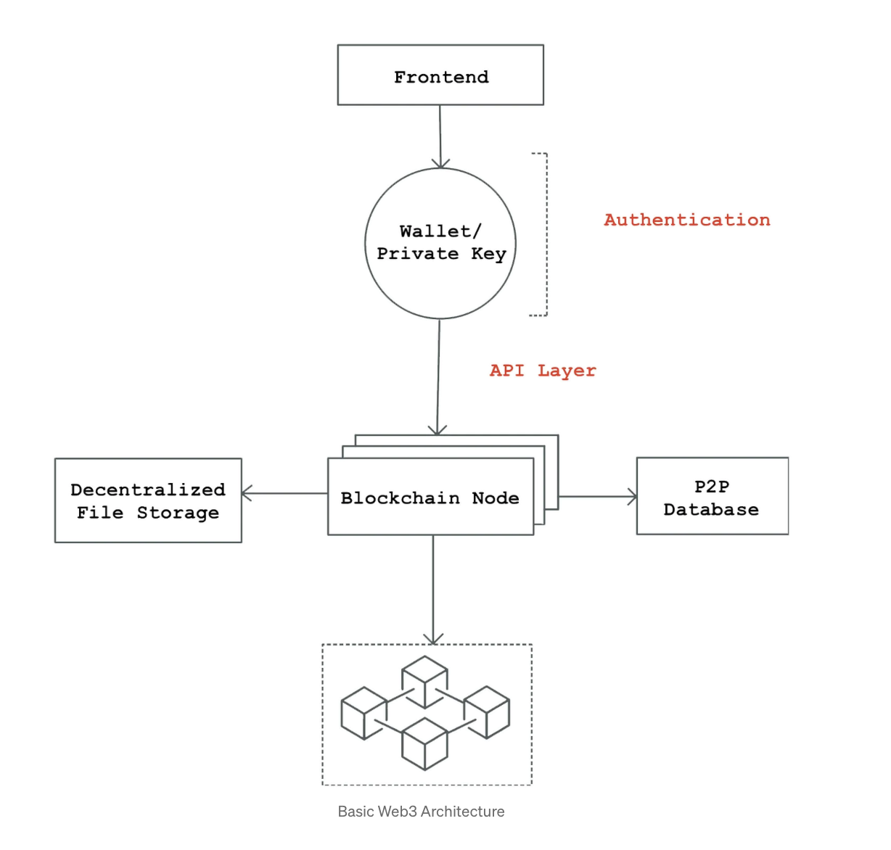
Between I & H & V is a Web-3 System [3]
Notes:
[3]: (Agrawal, 2022)
Term explaination: A P2P (Peer-to-Peer) protocol enables nodes to communicate within the network and exchange information about transactions and new blocks [3].

Slide 100
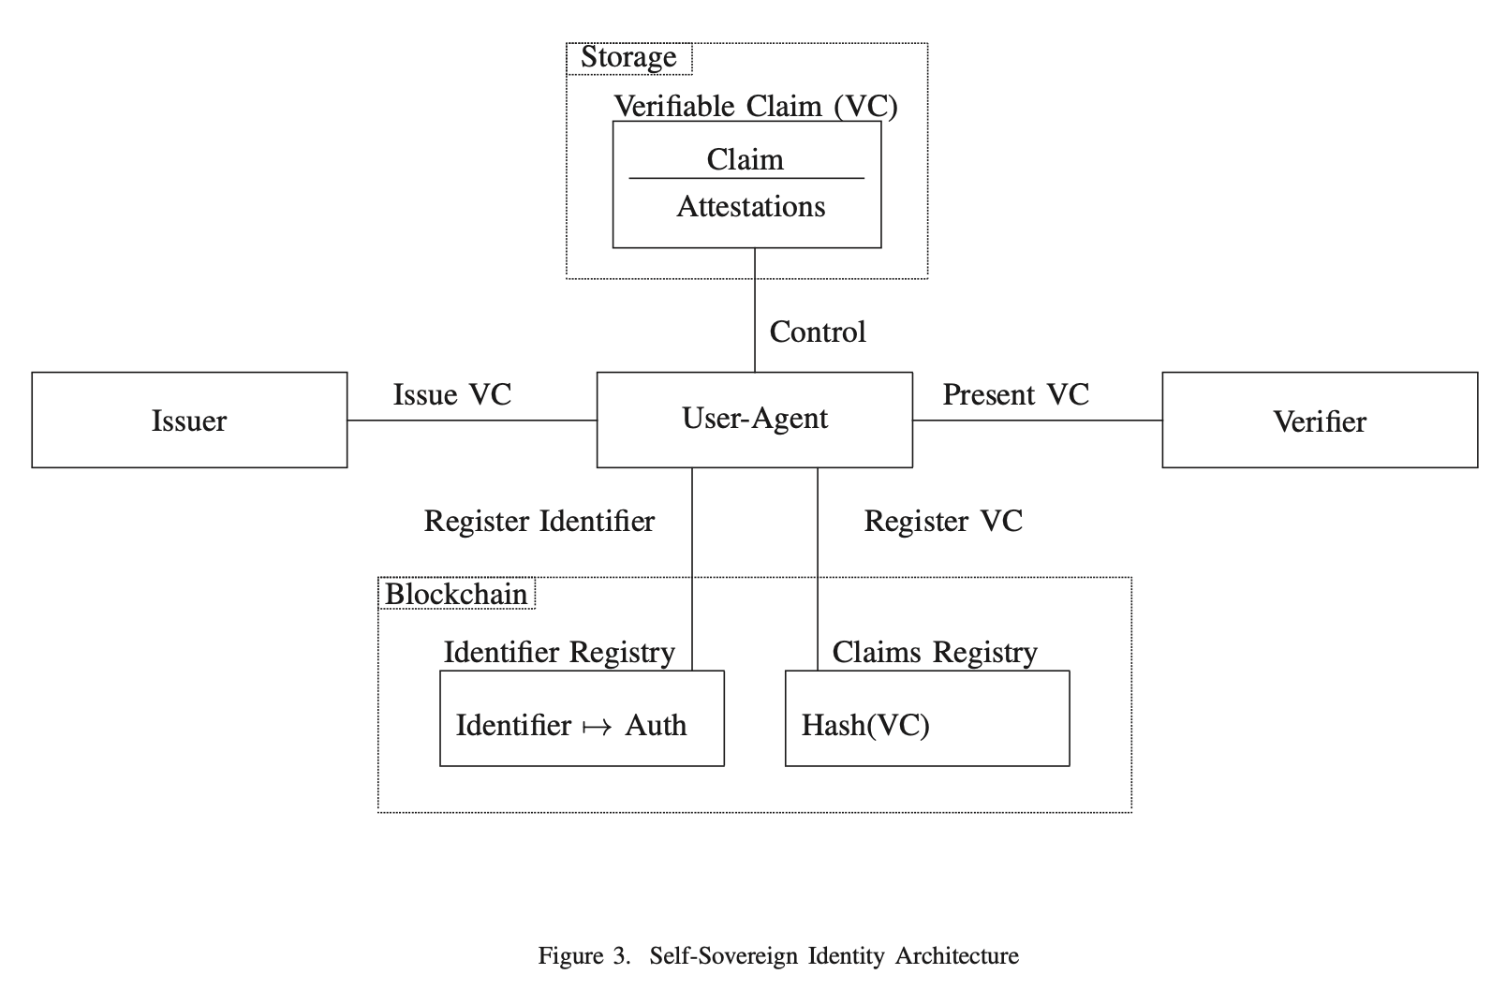
Hybrid Options (Off-Chain & On-Chain) [9]
I create & issue the credential to H off-chain
I published a certain number of claims that V (or D) can ask H
V (or D) can create a smart contract to check H’s proof validity
Smart contract runs and deploys a block on the chain as a transaction
Notes:
[9]: (Mühle et al., 2018)

Slide 101
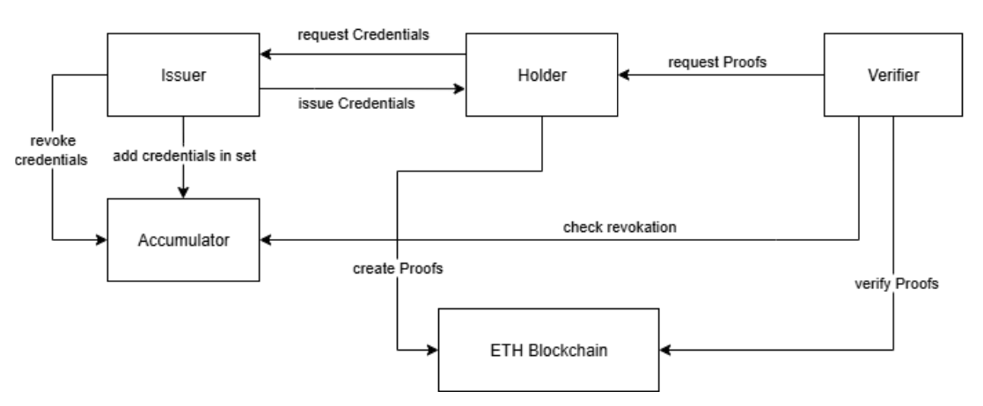
New pipeline with Accumulator
Accumulator:
this is our extra-module/system in additional to the old one(Muth) with additional of Acc for revocation check of credential

Slide 102
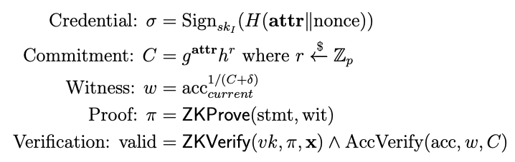
Mathematic foundation

Slide 103


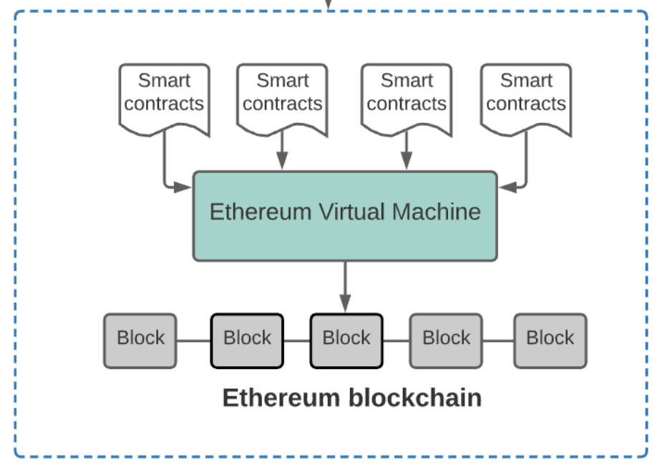


Design Idea 1: Using Accumulator
Off-Chain Region
Merkel’s Tree
(Issuer’s Public Data & Cred-Def & Cred-Schema)
On-Chain Region
Issuer
(sk_I)
Root-computing
Time-direction
Smart-contract bytecodes been deployed
S.C sending
Merkel-root
Database
C&D(1)
Accumulator
(α-t)
ark_groth16/ other-logic (rust)/ circom
ZKP proof
(proof.json/ proof.bin) &
(public.json)
(contain contract-add)
Holder
(Cred, Wit , x)
Proof-gen & Ver:
Deltas
(Revoked-List x’)
read
Serialize to S.C input as funct input
Verifier (the D-Apps)
C&D (2)
Red: Secret values
Green: Agents
Black: Public values
Cred = (Sig, Mes)
Sig = Sign(sk_I, Mes)
Note: All blocks include a ledger – this ledger is the Merkle root (not the Merkel in the H’s ZKP-Tree)
We assume both H & V take the data from the latest block in the EVM
Proof generation requires these values: Statement to proof, Witness, (ZKP-logic || circuit)
S.C: Smart-Contract
C&D: Compile & Deploy the byte-code from the source-smart-contract Etherium network
Notes:
How the issuer & holder & any agent (as D-Apps interact with smart-contract) – using ABI –offchain file (the interface)
contract-address: the location to store the bytes-code of logic in the EVM
-----------
✅ When starting fresh (new schema, new accumulator, new root):
You need 2 smart contracts:
Issuer’s contract — to register the new Merkle root (e.g., updated public key, schema, accumulator root).
Verifier’s contract — to verify ZKP proofs using that root.
So: Issuer sets the reference, Verifier uses it.
✅ When schema does NOT change (root stays the same):
You only need 1 contract:
The Verifier’s contract which uses the already-published root from the Issuer’s previous deployment.
Verifiers just keep referring to the existing contract to get the latest root.
No need for Issuer to post again unless they want to update.
🧠 So your final insight is correct:
✔️ At first: 2 contracts.
✔️ Later with no schema/root change: 1 verifier contract is enough.

Slide 104
Design Idea 2: Using Public Revoked List
Off-Chain Region
Merkel’s Tree
(Issuer’s Public Data & Cred-Def & Cred-Schema)
On-Chain Region
Issuer
(sk_I)
Root-computing
Time-direction
Smart-contract bytecodes been deployed
S.C sending Merkel-root
Database
C&D(1)
List of Revoked Cred
(Hash(Sig))
ark_groth16/ other-logic (rust)/ circom
ZKP proof
(proof.json/ proof.bin) &
(public.json)
(contain contract-add)
Holder
(Cred,Hash(sig))
Proof-gen & Ver:
read
Serialize to S.C input as funct input
Verifier (the D-Apps)
C&D (2)
Red: Secret values
Green: Agents
Black: Public values
Cred = (Sig, Mes)
Sig = Sign(sk_I, Mes)
Note: All blocks include a ledger – this ledger is the Merkle root (not the Merkel in the H’s ZKP-Tree)
We assume both H & V take the data from the latest block in the EVM
Proof generation requires these values: Statement to proof, Witness, (ZKP-logic || circuit)
S.C: Smart-Contract
C&D: Compile & Deploy the byte-code from the source-smart-contract to the Etherium network
Notes:
How the issuer & holder & any agent (as D-Apps interact with smart-contract) – using ABI –offchain file (the interface)
contract-address: the location to store the bytes-code of logic in the EVM
-----------
✅ When starting fresh (new schema, new accumulator, new root):
You need 2 smart contracts:
Issuer’s contract — to register the new Merkle root (e.g., updated public key, schema, accumulator root).
Verifier’s contract — to verify ZKP proofs using that root.
So: Issuer sets the reference, Verifier uses it.
✅ When schema does NOT change (root stays the same):
You only need 1 contract:
The Verifier’s contract which uses the already-published root from the Issuer’s previous deployment.
Verifiers just keep referring to the existing contract to get the latest root.
No need for Issuer to post again unless they want to update.
🧠 So your final insight is correct:
✔️ At first: 2 contracts.
✔️ Later with no schema/root change: 1 verifier contract is enough.

Slide 105
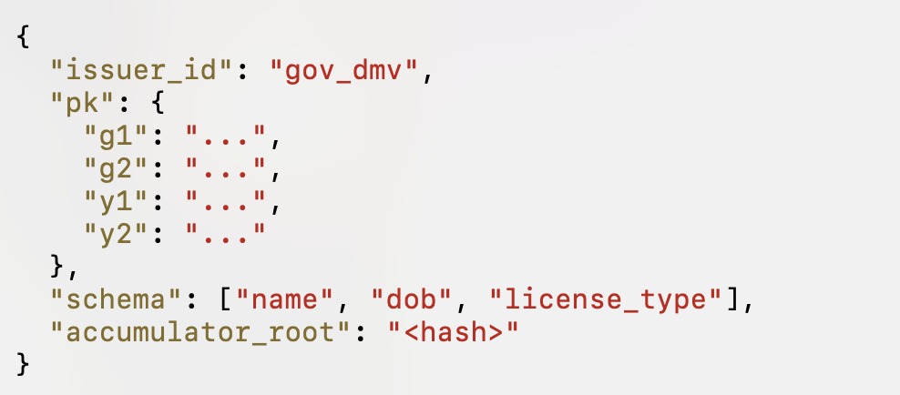
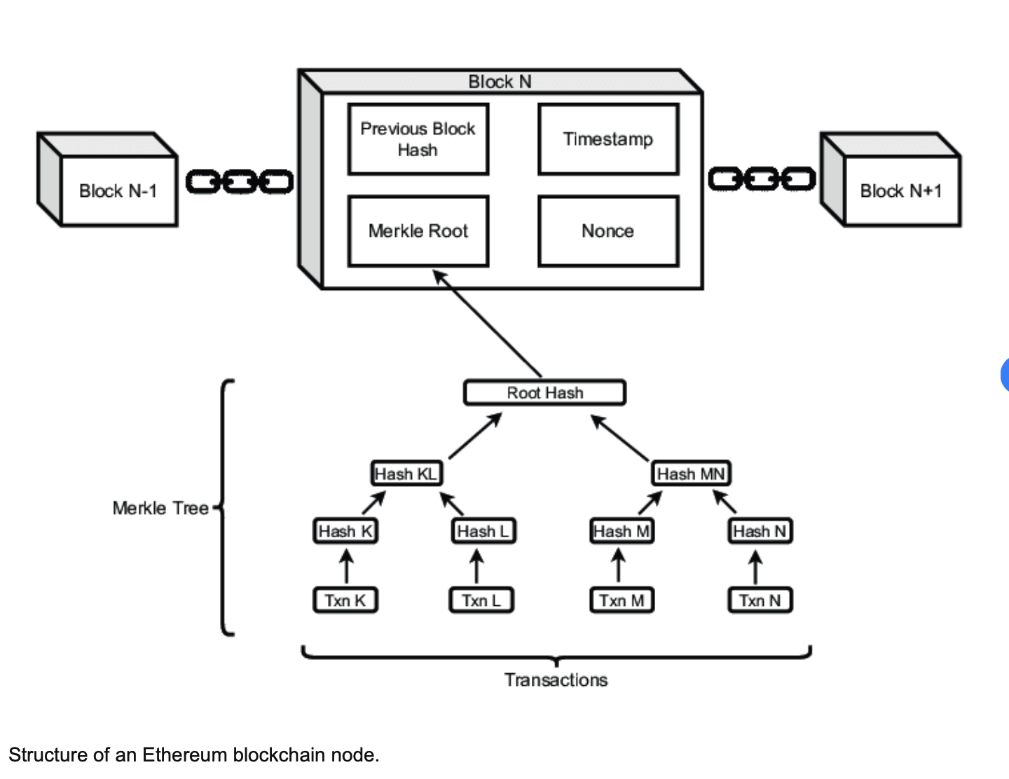
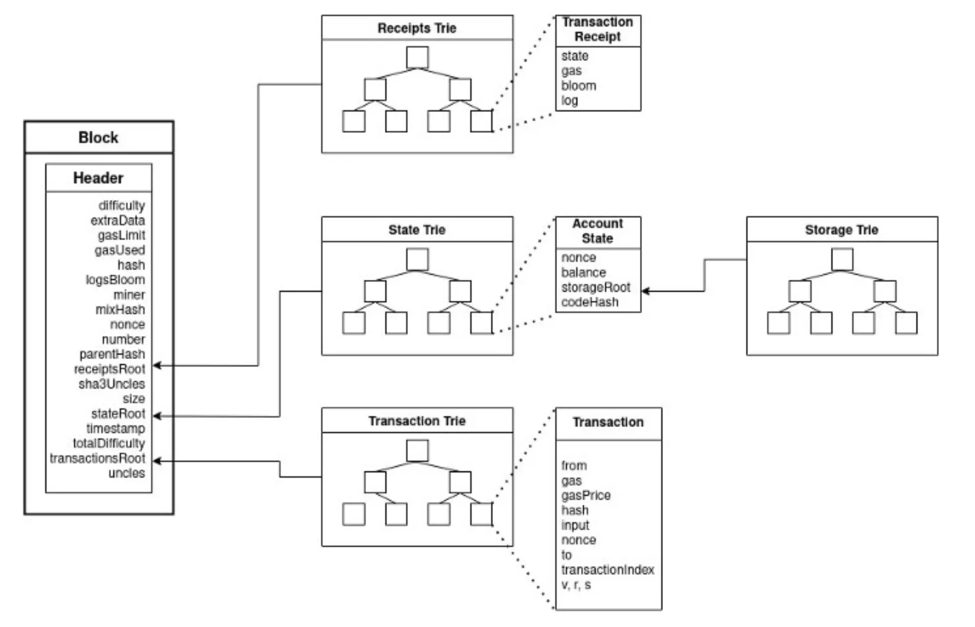
2 types of ledger designs (depends on the ways issuer store the tree)
Ledger 1
(Merkel-Patrica-Trie)
Credential-Def -> credentialDefinitionsRoot
Credential-Schema -> credentialSchemasRoot
Meta-Data of Issuer_Sign Algorithm -> issuerMetaRoot
Issuer-Pk-Root -> issuer_root
Ledger 2 (*)
(Merkel-Tree)
Each Leaf = 1 Change’s in issuer’s public Data

Slide 106
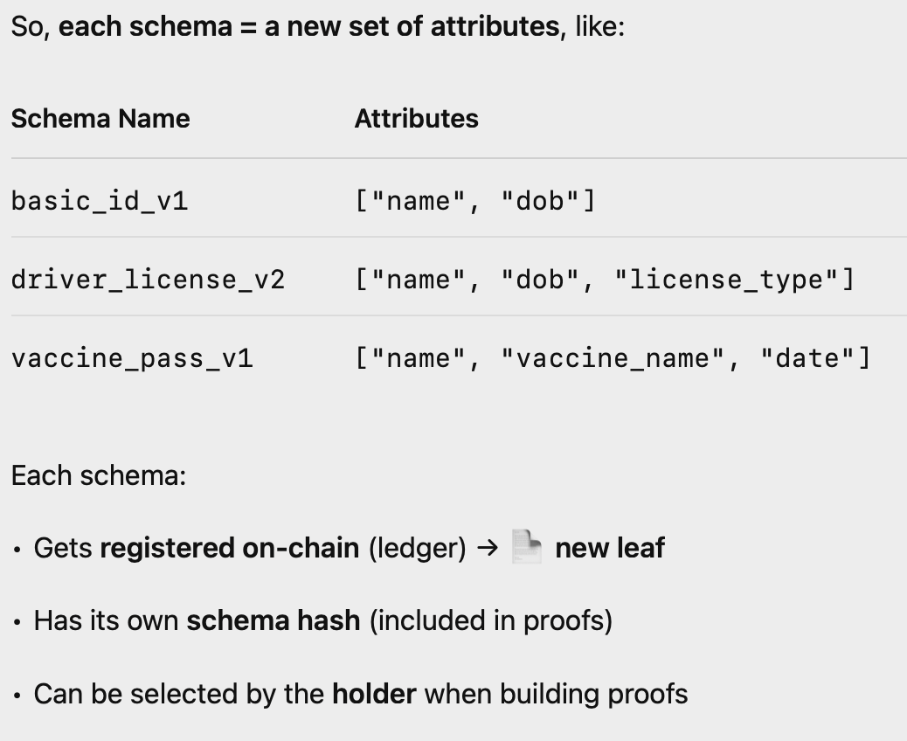
What was each node in ledger can be represented by
Each node in the ledger’s MT can act like a set of queries that V can ask H, and I allow V to ask on H
=> (For case of the same types of signature & same PK)
=> But it can be adding more – like adding the types of the signature’s algorithm (for signature specification), adding pk (for updating epoch)

Slide 107
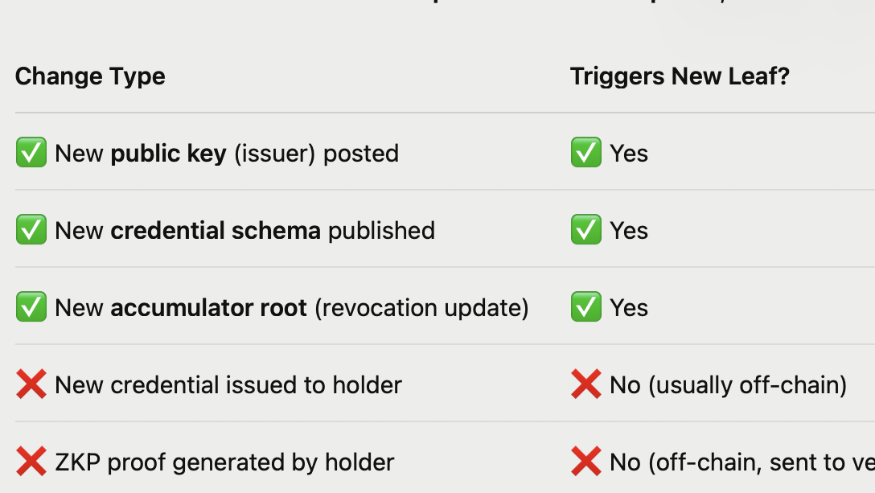

Slide 108
The Empirical Study
Group 1
CS-3372 Final Project Report
Khiem Nguyen, Dung Nguyen: Experiment Design

Slide 109
Developing Environment
Techstack
Algorithm
Geth (Ethereum blockchain simulation)
Solidity
Rust
Circom (ZK_Snarks)
Nodejs 18 (API)
Signature (BLS_12_381)
ZKP (ZK_Snarks)

Slide 110
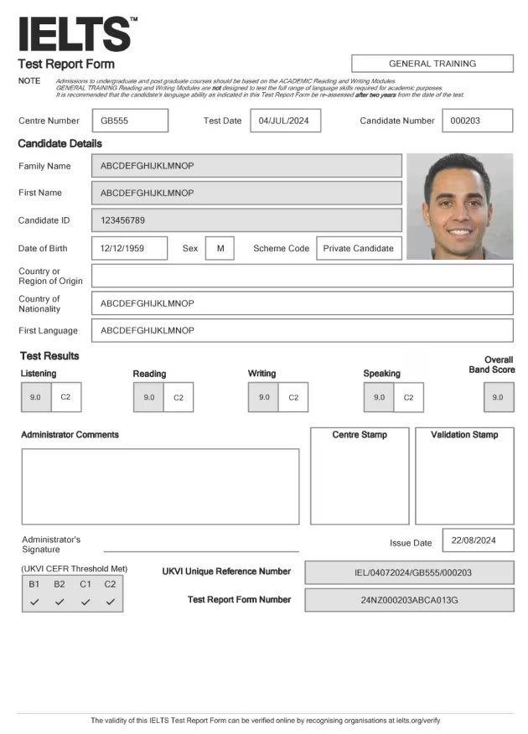
IELTS Certification Verification
Credential:
=======================
name: Alice Johnson
listening: 8.0 reading: 7.5
writing: 7.0
speaking: 8.5 =======================

Slide 111
IELTS Certification Verification
Credential:
=======================
name: Alice Johnson
listening: 8.0 reading: 7.5
writing: 7.0
speaking: 8.5 =======================
Signature:
=======================
secret: abc123
salt: def456
amount: 1000 =======================

Slide 112
IELTS Certification Verification
Credential:
=======================
name: Alice Johnson
listening: 8.0 reading: 7.5
writing: 7.0
speaking: 8.5 =======================
Signature:
=======================
commitment: 0xd95d…
nullifier: 0x6ca13… =======================

Slide 113
IELTS Certification Verification
Zero-Knowledge Proof:
=======================
a: [107…,339…, 1]
b: [151…,205…,157…]
c: [123…,322…,233…] =======================

Slide 114
IELTS Certification Verification
Zero-Knowledge Proof:
=======================
a: [107…,339…, 1]
b: [151…,205…,157…]
c: [123…,322…,233…] =======================
Verifier

Slide 115
IELTS Certification Verification
Zero-Knowledge Proof:
=======================
a: [107…,339…, 1]
b: [151…,205…,157…]
c: [123…,322…,233…] =======================
Verifier
Accumulator
Ledger
Valid Cred

Slide 116
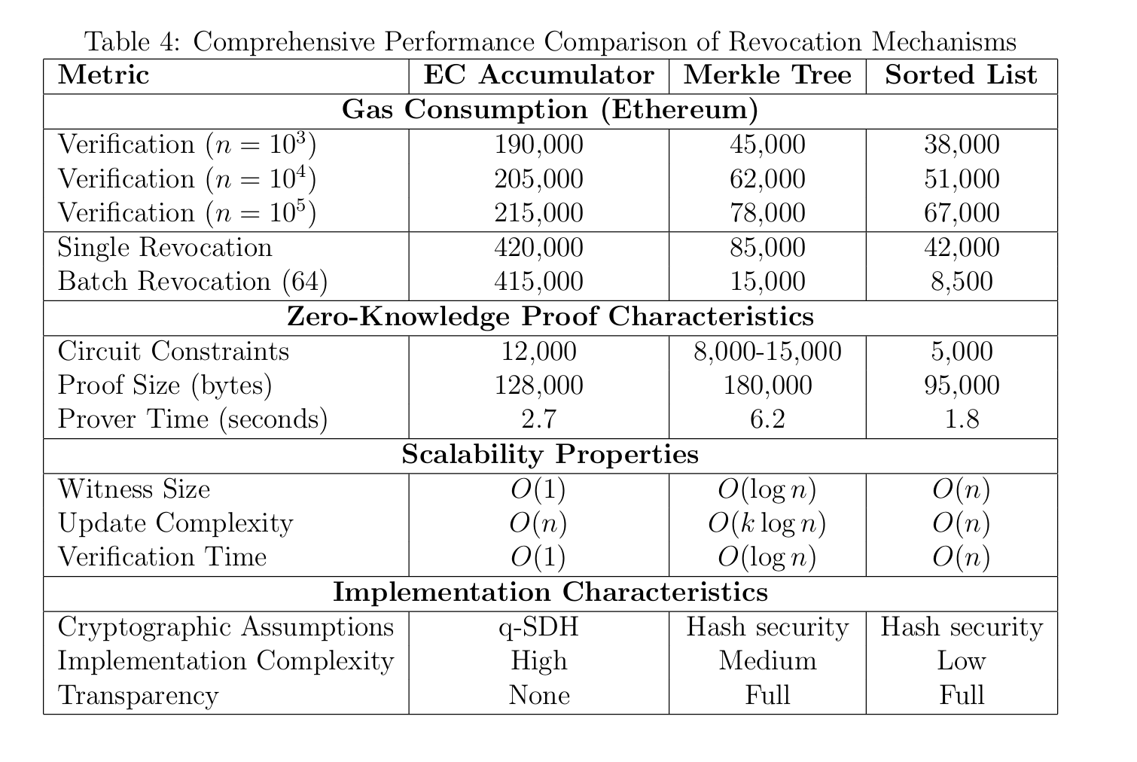
Cost Evaluation

Slide 117
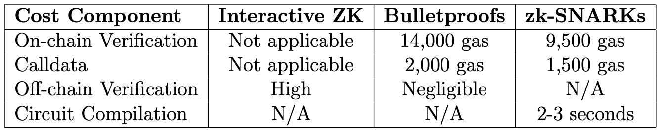
Cost analysis

Slide 118
Conclusion
Group 1
CS-3372 Final Project Report
Notes:
(*): Team leading

Slide 119
Research Contributions
The development of the comprehensive system model specifically designed for anonymous credentials in gas-metered execution environments.

Slide 120
Research Contributions
Providing:
a comparative analysis of revocation mechanisms,
showing trade-offs between elliptic curve accumulators (efficient verification but costly updates)
Merkle trees (scalable updates but less efficient verification), o
ffering quantitative guidance for system design.

Slide 121
Research Limitations and Future Work
Cryptographic Assumptions:
Reliance on the q-Strong Diffie–Hellman assumption for elliptic-curve accumulators introduces a potential single point of failure.
Trusted setup requirements in some zk-SNARKs pose similar risks.
Future work should:
Investigate more conservative cryptographic assumptions.
Explore transparent setup alternatives to avoid trust bottlenecks.

Slide 122
Research Limitations and Future Work
Scalability issues with EC accumulators, which fail at very large set sizes.
Merkle trees have call-data scaling problems.
A hybrid approach or advanced cryptographic methods may solve this issue.

Slide 123
Research Limitations and Future Work
User experience challenges:
proof generation is too slow (2.7–6.2s),
witness management is complex for non-technical users.
Future research should focus on:
hardware acceleration, improved circuit architectures, and user interface designs.
Economic sustainability depends on evolving blockchain fee markets and layer-2 scaling solutions.

Slide 124
Reference
Group 1
CS-3372 Final Project Report
Materials that you can use to fact-check us !
Notes:
(*): Team leading

Slide 125
Reference List
[0]: Slamanig, D. (2025). Privacy-Preserving Authentication: Theory vs. Practice. ArXiv.org. https://arxiv.org/abs/2501.07209v1
[1]: Muth, R., Galal, T., Heiss, J., & Tschorsch, F. (2022). Towards Smart Contract-based Verification of Anonymous Credentials. Cryptology EPrint Archive. https://eprint.iacr.org/2022/492

Slide 126
Reference List
[2]: FinCEN - Financial Crimes Enforcement Network. (2019). Application of FinCEN’s Regulations to Certain Business Models Involving Convertible Virtual Currencies (p. 18). https://www.fincen.gov/sites/default/files/2019-05/FinCEN%20CVC%20Guidance%20FINAL.pdf
[3]: Agrawal, Y. (2022, May 30). A Beginners’ guide the basic Web3 Architecture and Tech Stack. Web3Auth. https://medium.com/toruslabs/a-beginners-guide-the-basic-web3-architecture-and-tech-stack-81f2061d263c
[4]: Flamini, A., Silvio Ranise, Sciarretta, G., Scuro, M., Smaniotto, N., & Tomasi, A. (2025). Public Key Accumulators for Revocation of Non-Anonymous Credentials. Cryptology EPrint Archive. https://eprint.iacr.org/2025/549

Slide 127
Reference List
[5]:Laurie, B., & Kasper, E. (n.d.). Revocation Transparency (pp. 1–3). Retrieved August 16, 2025, from https://www.links.org/files/RevocationTransparency.pdf
[6]: Bünz, B., Bootle, J., Boneh, D., Poelstra, A., Pieter Wuille, & Maxwell, G. (2017). Bulletproofs: Short Proofs for Confidential Transactions and More. Cryptology EPrint Archive. https://eprint.iacr.org/2017/1066
[7]: kd14. (2025, February 18). Sparse Merkle Tree vs Indexed Merkle Tree. Vac. https://forum.vac.dev/t/sparse-merkle-tree-vs-indexed-merkle-tree/438
[8]: Camenisch, J., Kohlweiss, M., & Soriente, C. (2008). An Accumulator Based on Bilinear Maps and Efficient Revocation for Anonymous Credentials. Cryptology EPrint Archive (Eprint.iacr.org). https://eprint.iacr.org/2008/539

Slide 128
Reference List
[9]: Mühle, A., Grüner, A., Gayvoronskaya, T., & Meinel, C. (2018). A survey on essential components of a self-sovereign identity. Computer Science Review, 30, 80–86. https://doi.org/10.1016/j.cosrev.2018.10.002
[10]: Stinson, D. R. (2019). Cryptography: Theory and Practice. (Original work published 1995)
[11]: Thaler, J. (2022). Proofs, Arguments, and Zero-Knowledge 1. https://people.cs.georgetown.edu/jthaler/ProofsArgsAndZK.pdf
[12]: Investopedia. (2025, February 9). Smart Contracts. Investopedia. https://www.investopedia.com/terms/s/smart-contracts.asp

Slide 129
Reference List
[13]:Tessaro, S., & Zhu, C. (2023). Revisiting BBS signatures. Annual International Conference on the Theory and Applications of Cryptographic Techniques. https://eprint.iacr.org/2023/275
[14]: Nguyen, L. (2005, April 28). Accumulators from Bilinear Pairings and Applications to ID-based Ring Signatures and Group Membership Revocation. Cryptology EPrint Archive. https://eprint.iacr.org/2005/123

Slide 130
Reference List
[15]: Groth, J. (2016). On the Size of Pairing-based Non-interactive Arguments. EPrint IACR. https://eprint.iacr.org/2016/260
[16]: Grassi, L., Dmitry Khovratovich, Rechberger, C., Roy, A., & Schofnegger, M. (2019). Poseidon: A New Hash Function for Zero-Knowledge Proof Systems. Cryptology EPrint Archive. https://eprint.iacr.org/2019/458

Slide 131
Reference List
[17]: Albrecht, M., Grassi, L., Rechberger, C., Roy, A., & Tiessen, T. (2016). MiMC: Efficient Encryption and Cryptographic Hashing with Minimal Multiplicative Complexity. Cryptology EPrint Archive. https://eprint.iacr.org/2016/492
[18]: Bertoni, G., Daemen, J., Peeters, M., & Assche, G. (2008). On the Indifferentiability of the Sponge Construction. https://www.iacr.org/archive/eurocrypt2008/49650180/49650180.pdf
[19]:Lefevre, C. (2023). Indifferentiability of the Sponge Construction with a Restricted Number of Message Blocks. Cryptology EPrint Archive. https://eprint.iacr.org/2023/217

Slide 132
Reference List
[20]: Haider, F. (2018). Compact Sparse Merkle Trees.
[21]: Indexed Merkle Tree (Nullifier Tree) | Privacy-first zkRollup | Aztec Documentation. (2025). Retrieved August 17, 2025, from Aztec.network website: https://docs.aztec.network/aztec/concepts/advanced/storage/indexed_merkle_tree
[22]: Merkle Tree | Pangea. (n.d.). Retrieved from pangea.cloud website: https://pangea.cloud/docs/audit/merkle-trees

Slide 133
Reference List
[23]: Privacy Stewards of Ethereum. (2023, August 17). Indexed Merkle Trees - Lasse/Aztec Labs. Retrieved August 17, 2025, from YouTube website: https://www.youtube.com/watch?v=x_0ZhUKtWSs
[24]: Nomos Team. (2025, March 17). Designing Nullifier Sets for Nomos Zones: Sparse vs Indexed Merkle Trees. Retrieved August 17, 2025, from Nomos Blog website: https://blog.nomos.tech/designing-nullifier-sets-for-nomos-zones-sparse-vs-indexed-merkle-trees/

Slide 134
Reference List
[25]: Notes (UTXOs) | Privacy-first zkRollup | Aztec Documentation. (2025). Retrieved August 17, 2025, from Aztec.network website: https://docs.aztec.network/aztec/concepts/storage/notes
[26]: Notes, Nullifiers, and Trees. (2025). Retrieved from Penumbra.zone website: https://protocol.penumbra.zone/main/concepts/notes_nullifiers_trees.html

